Slide 1

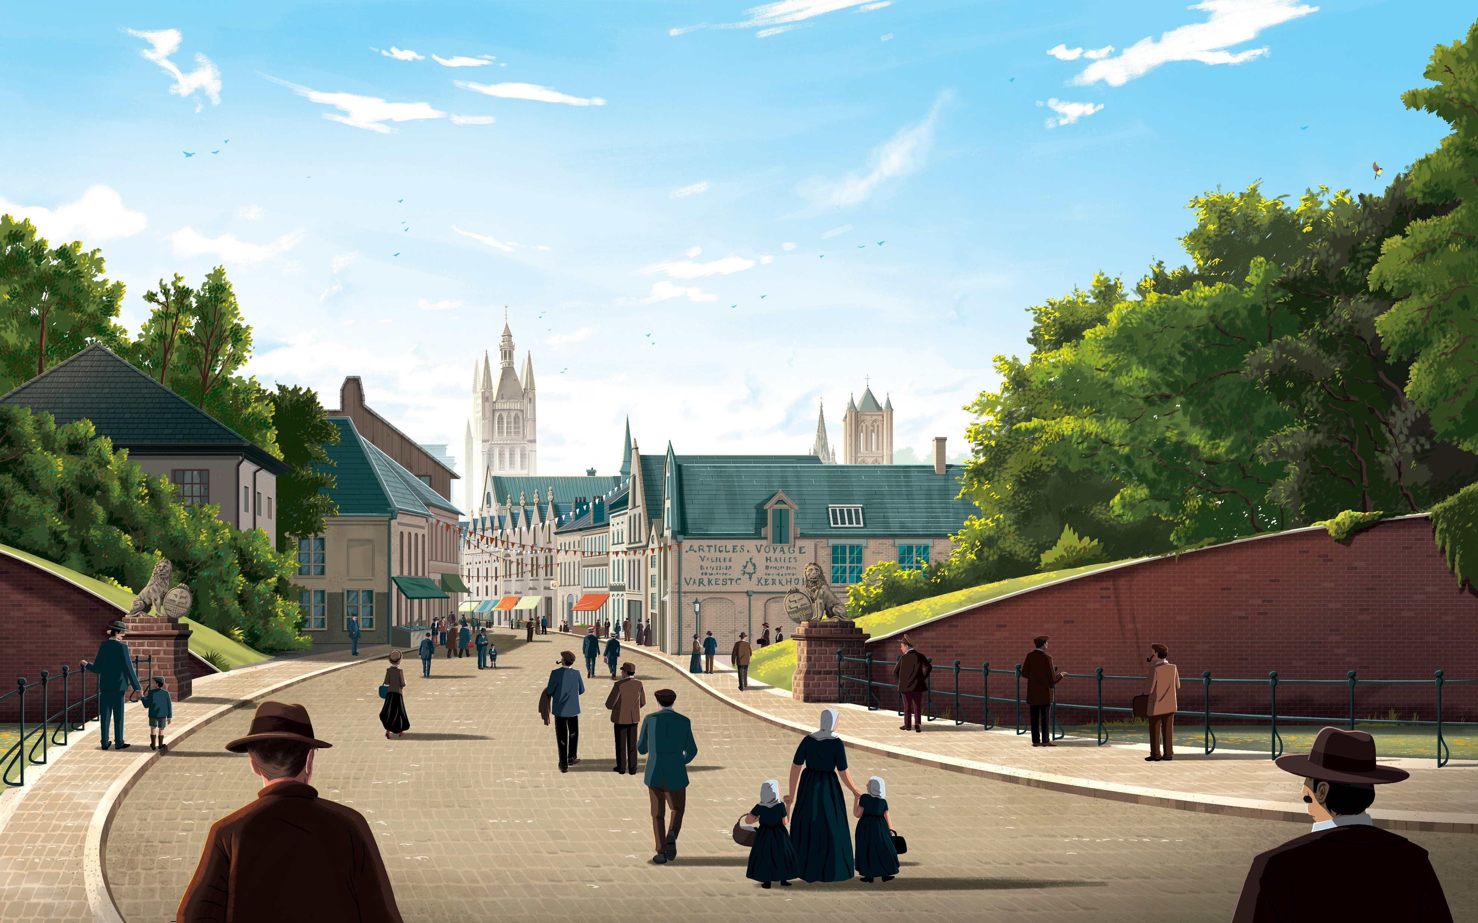
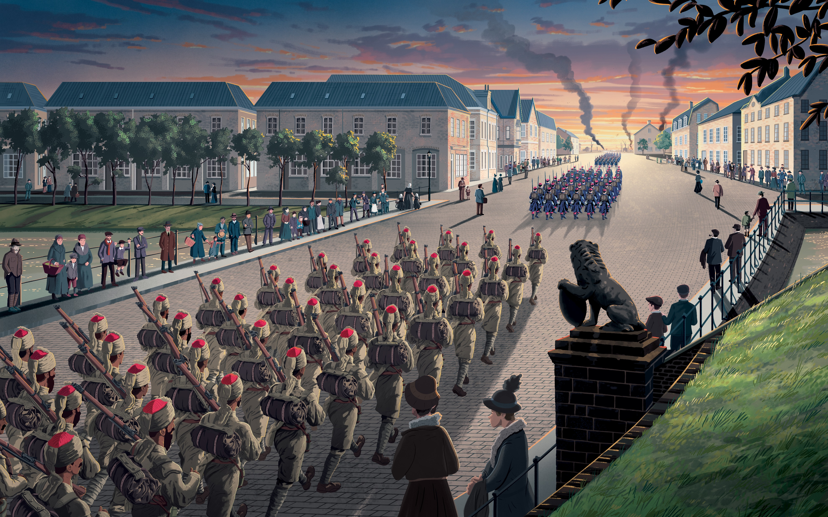
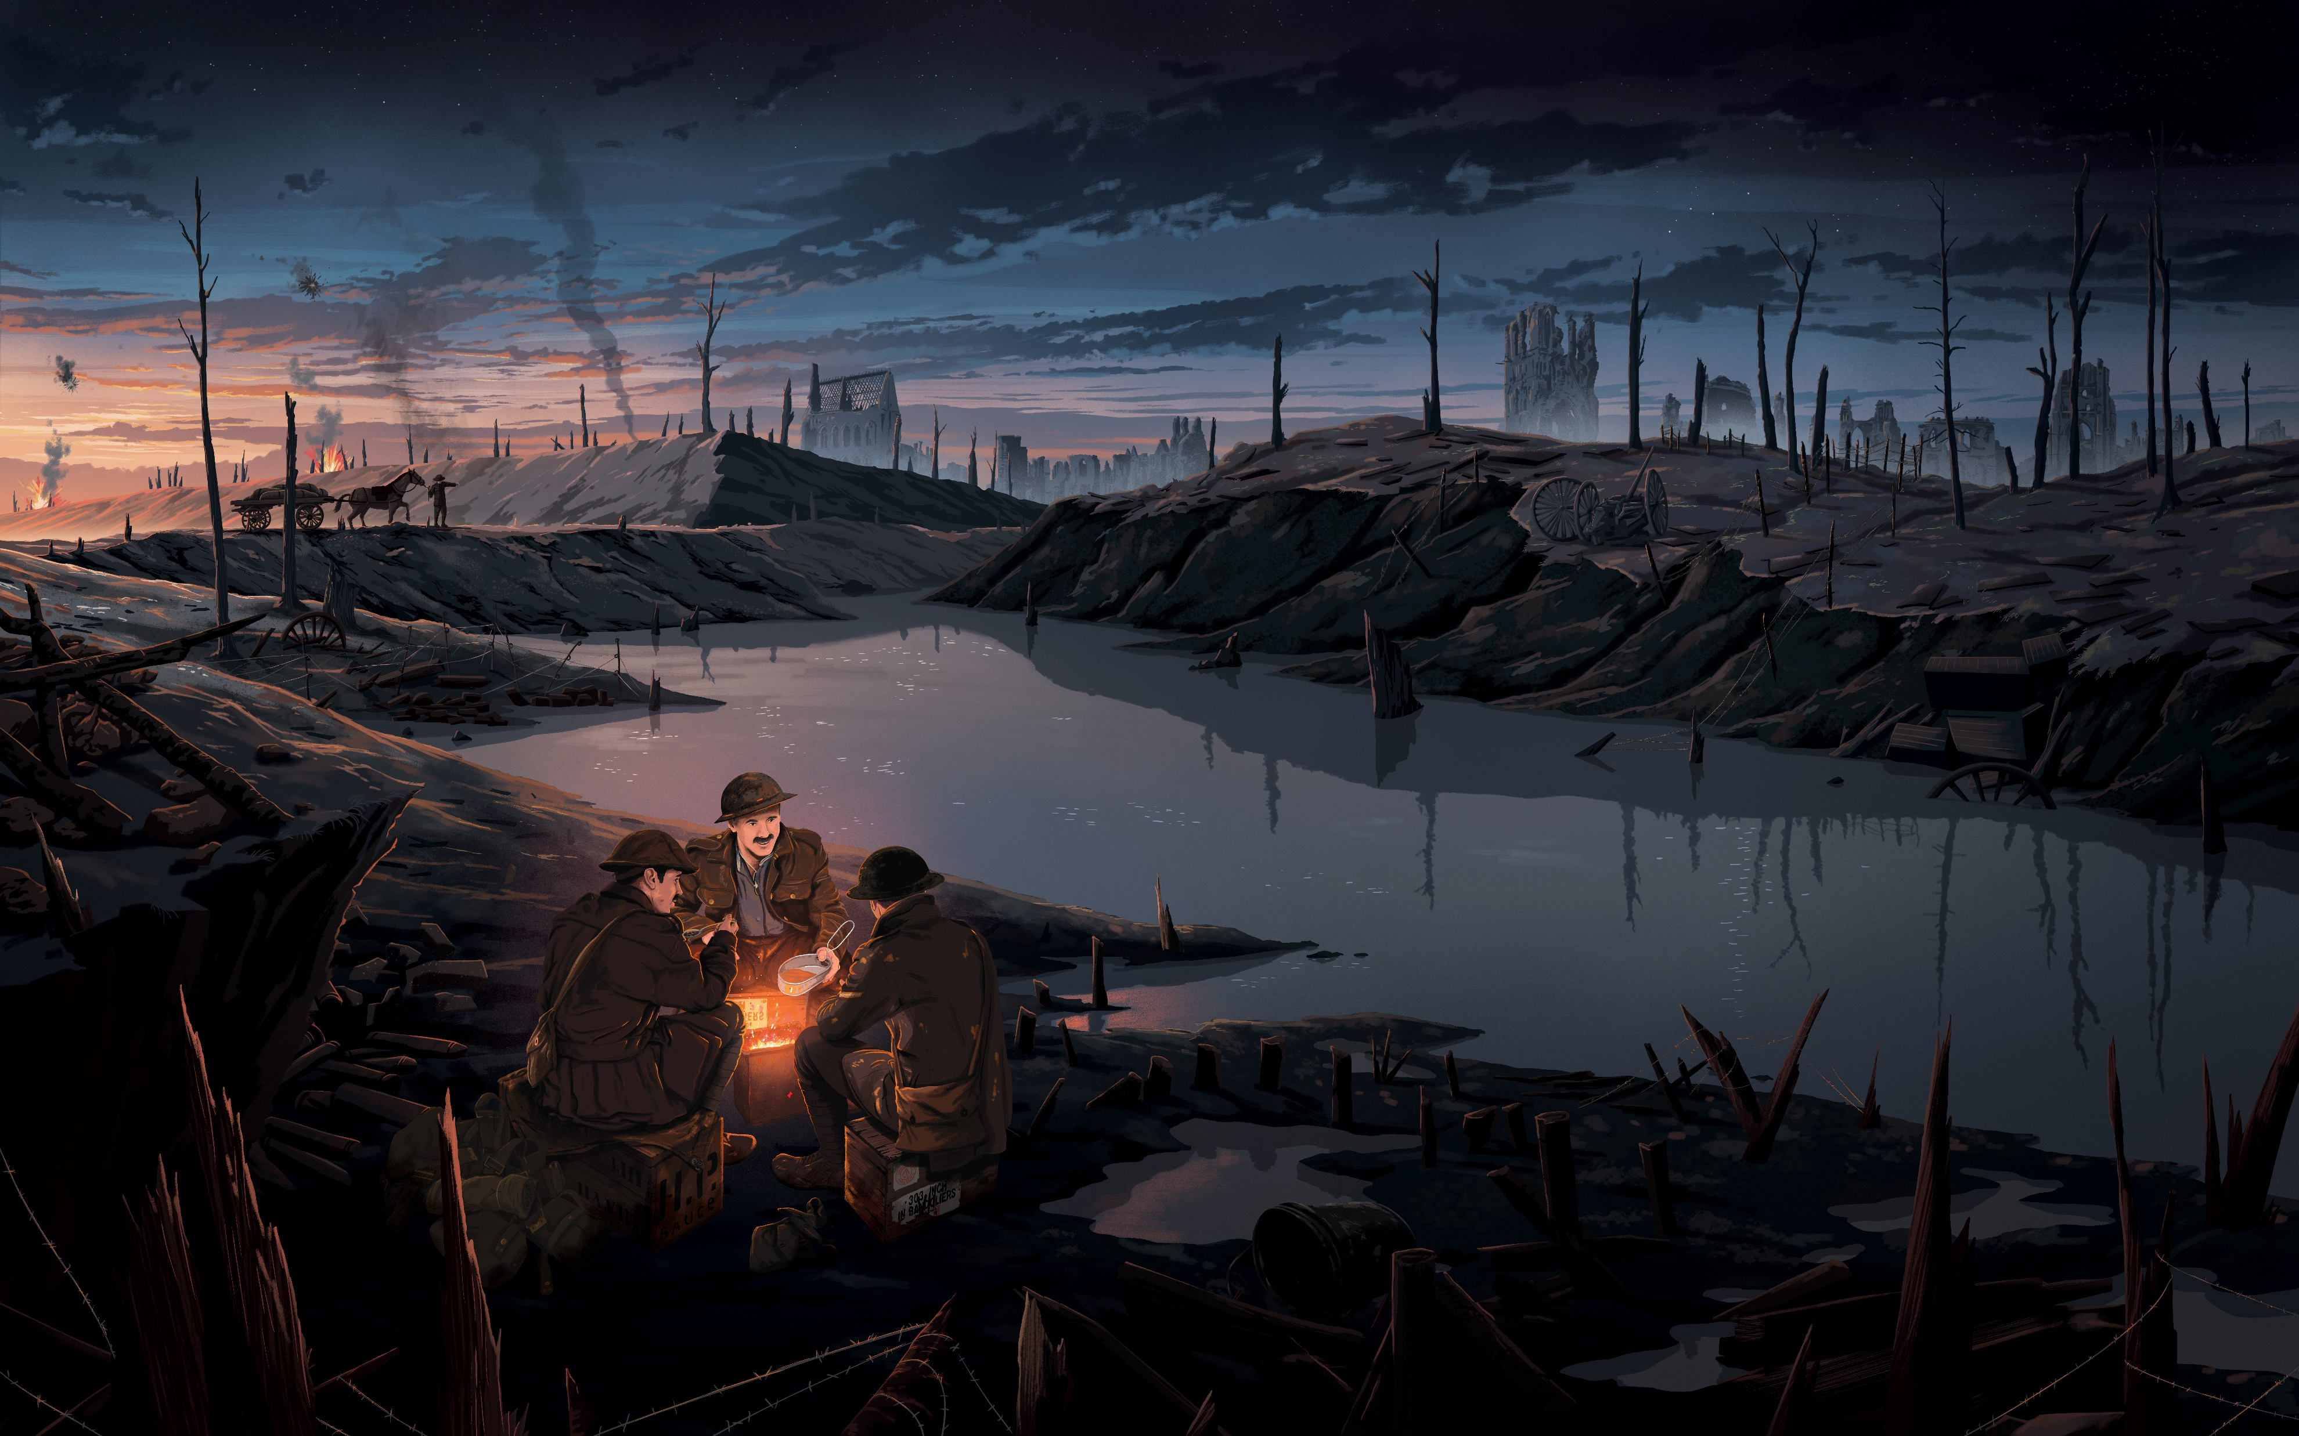
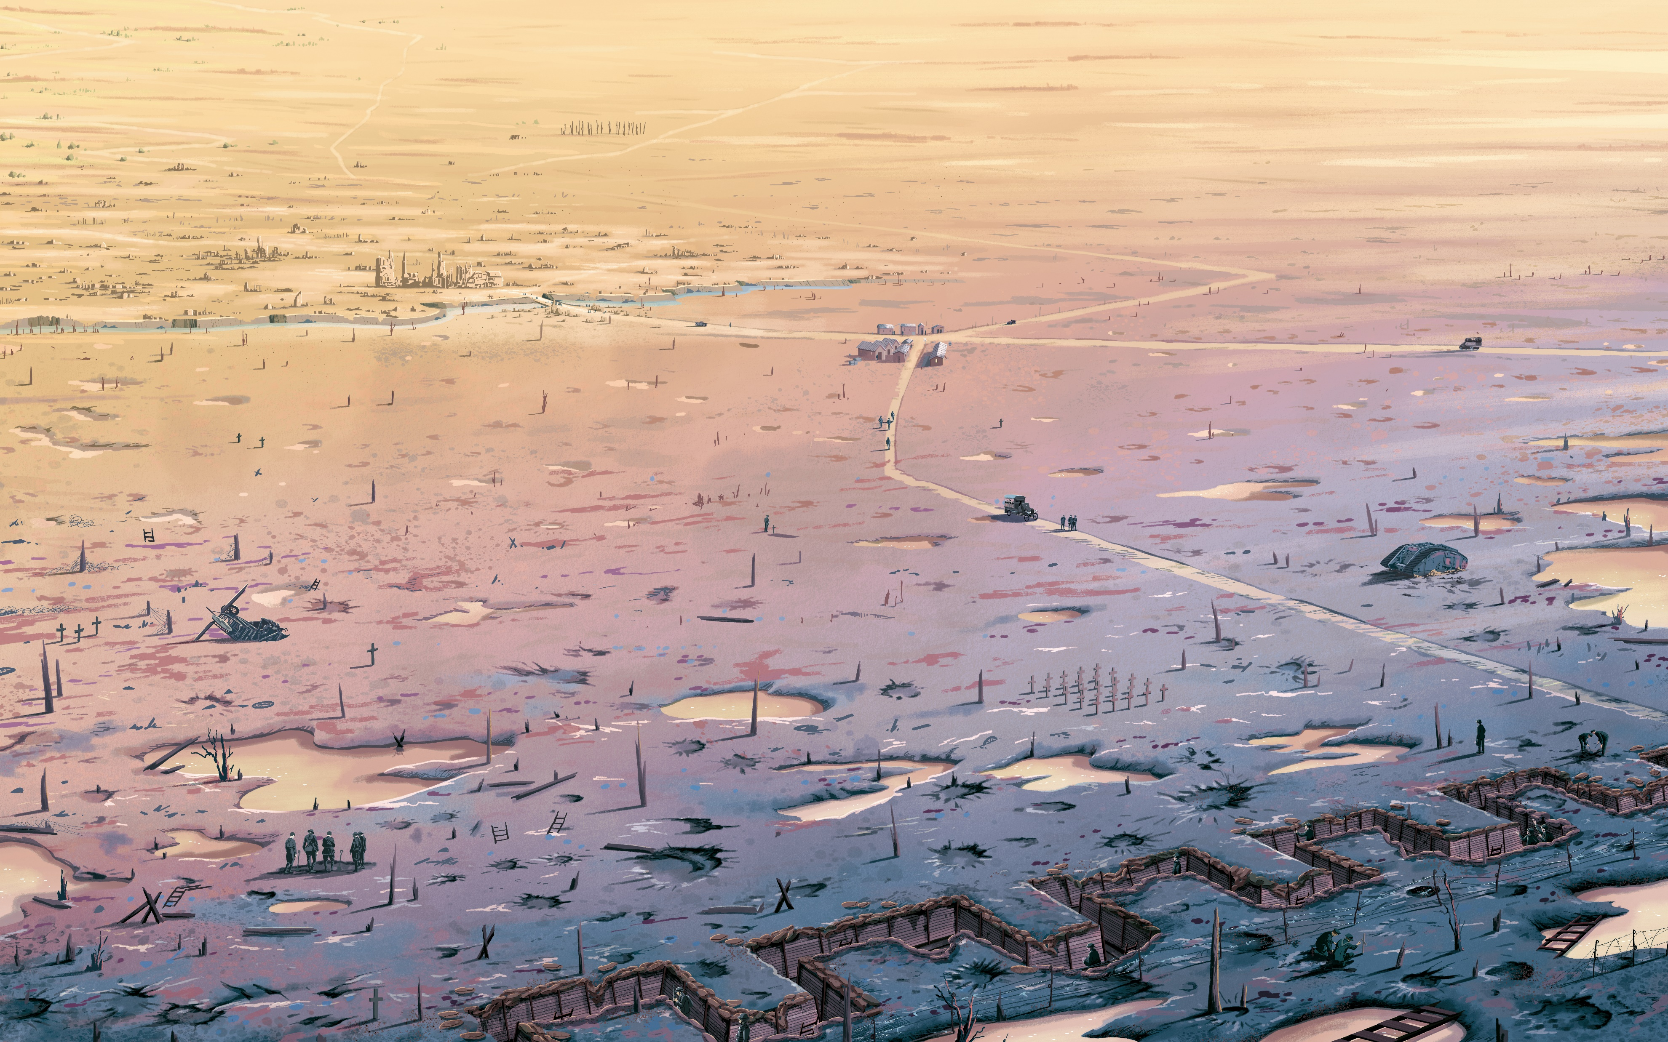
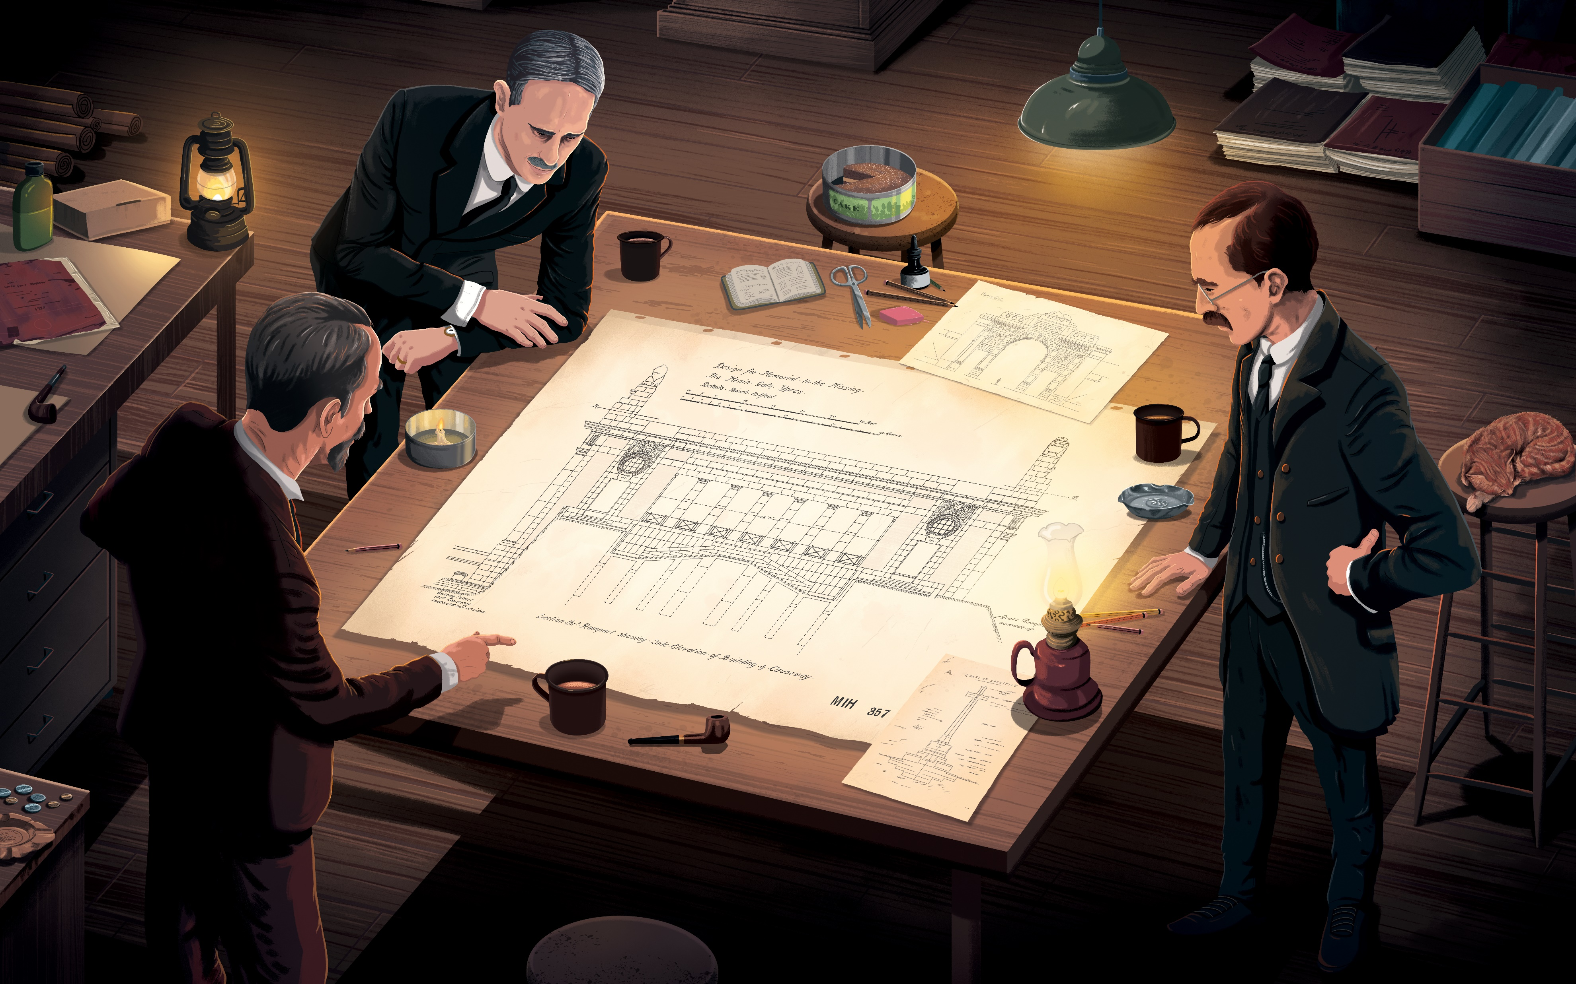
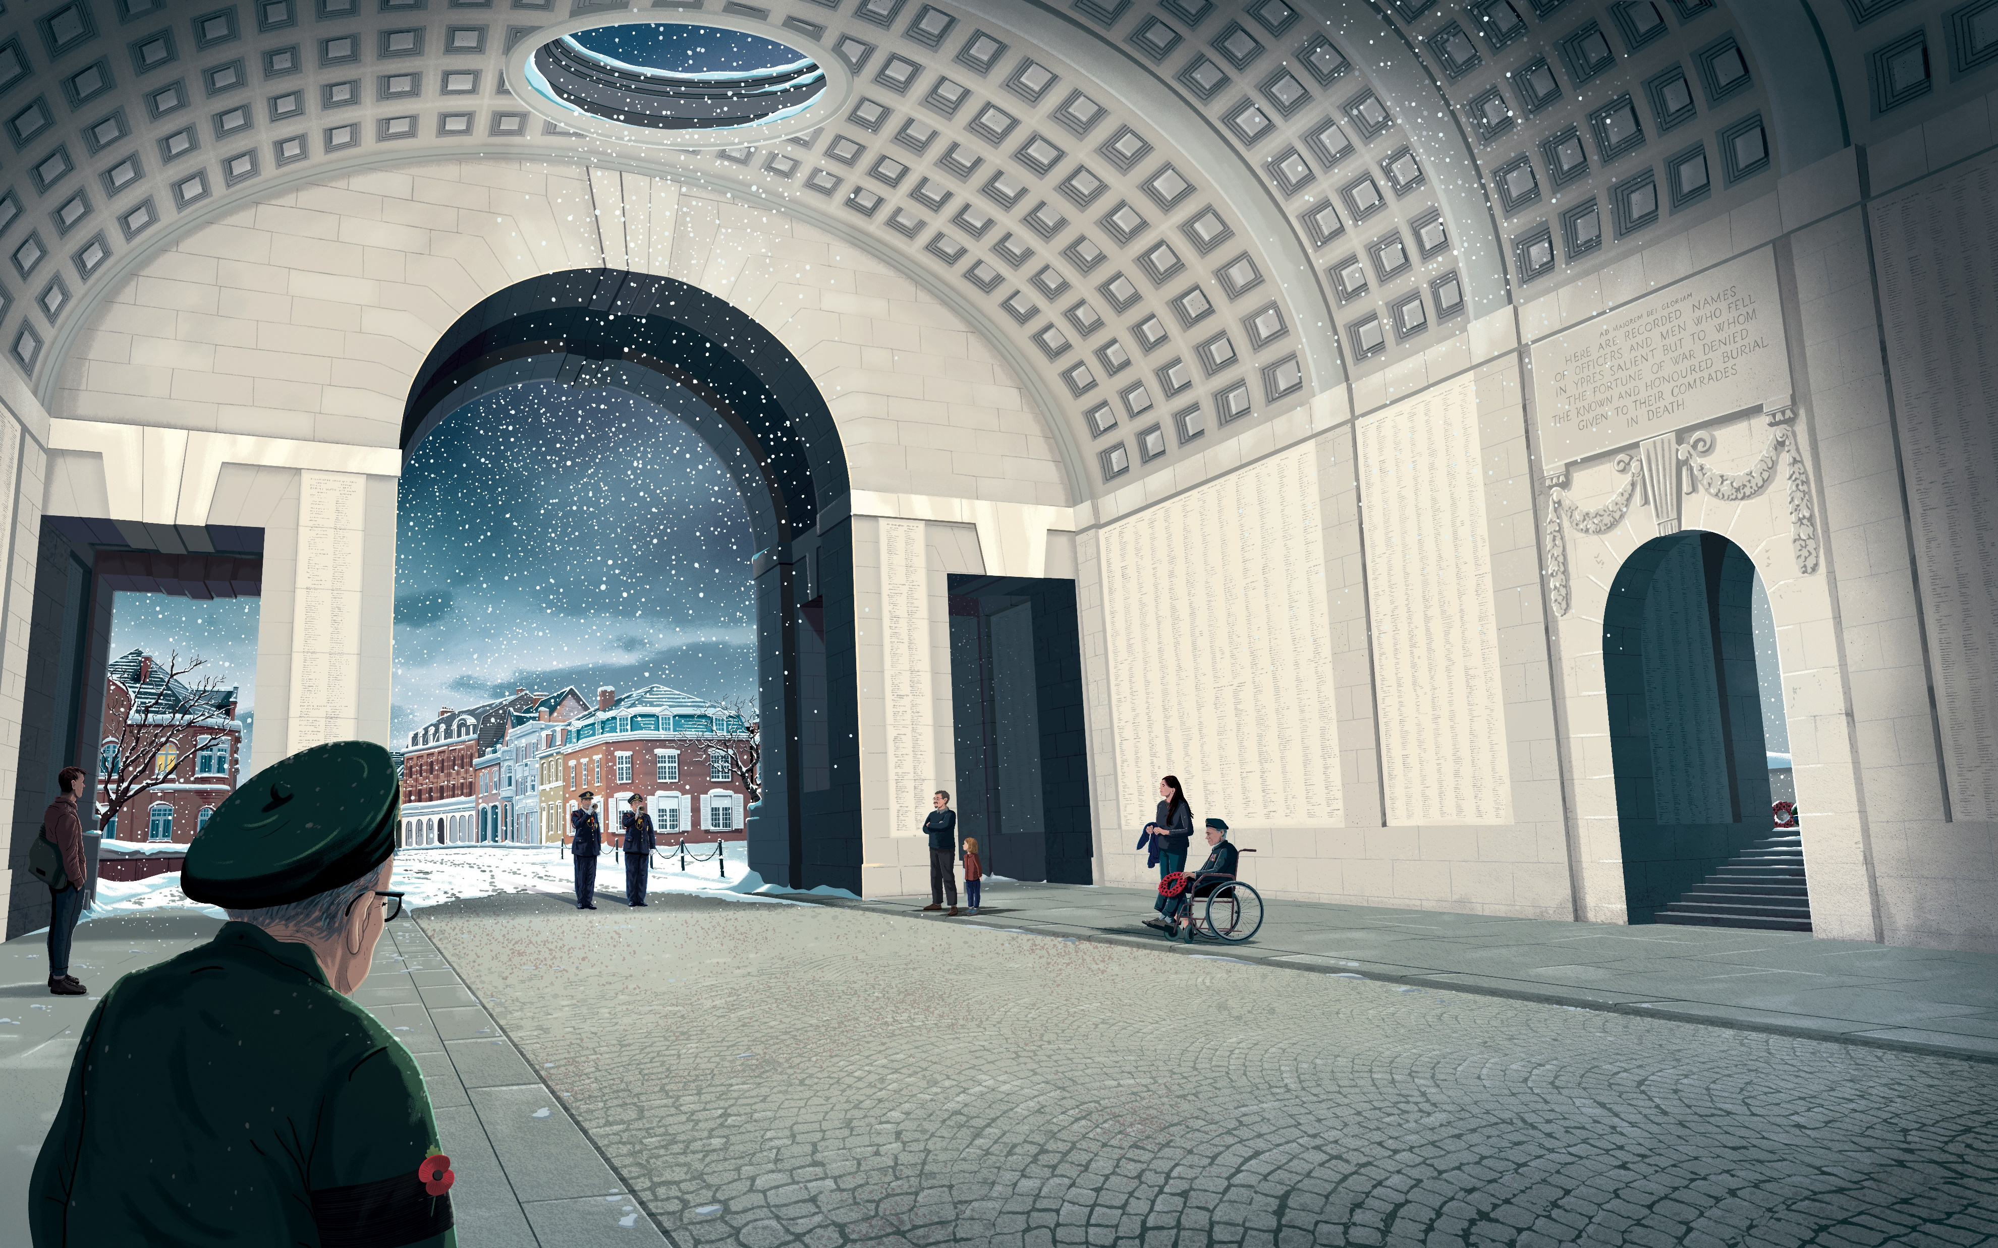
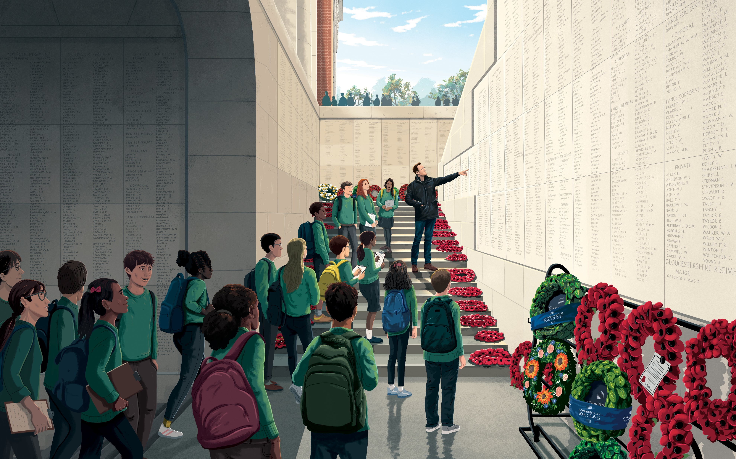
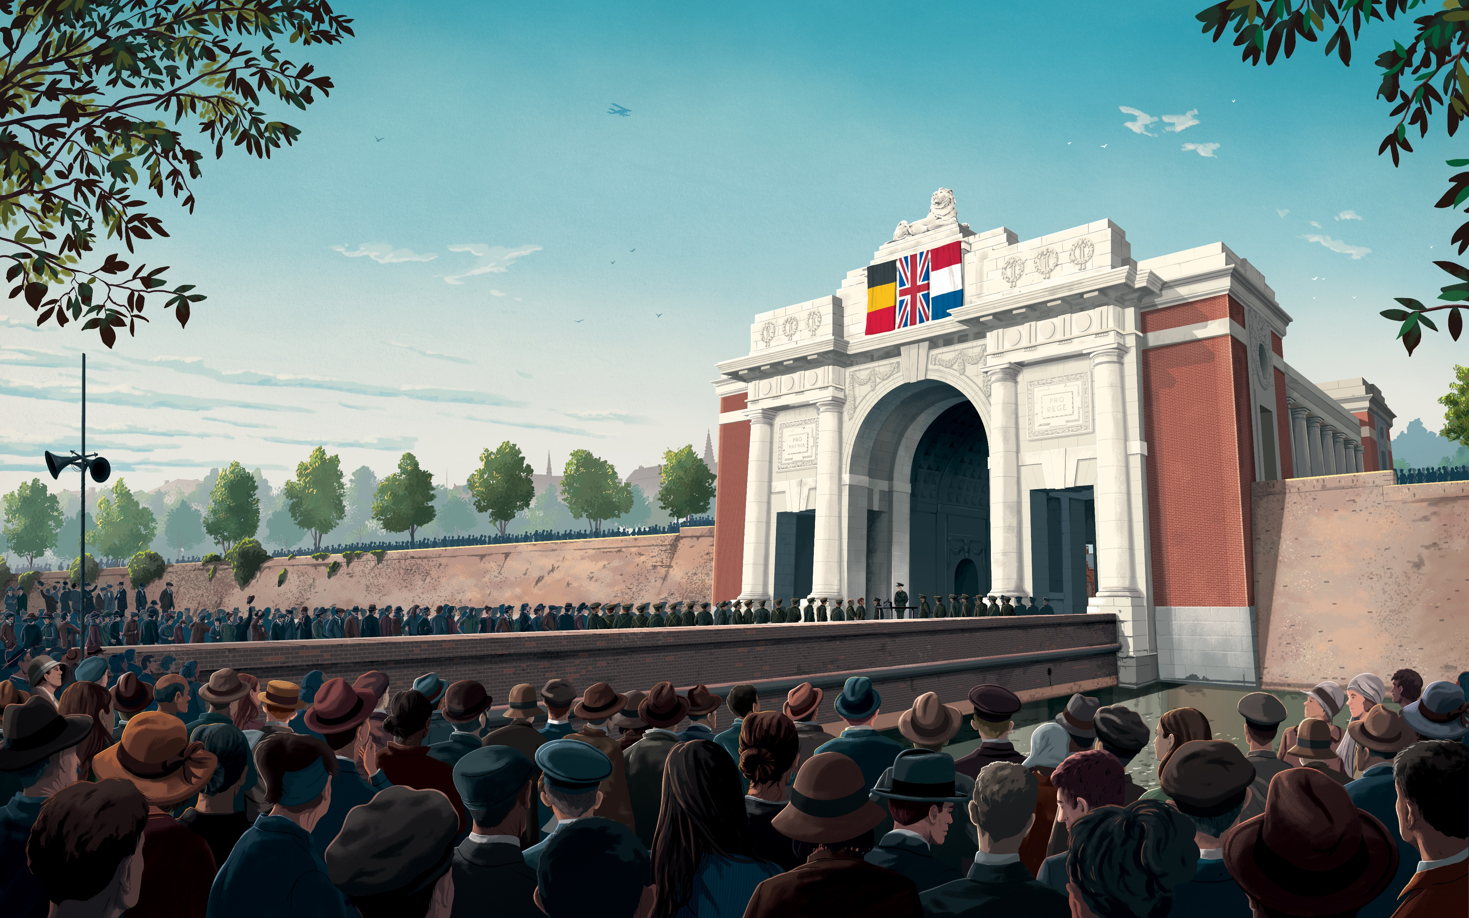
Menin Gate Moments…
Teacher notes
Starting in April 2023 the Commonwealth War Graves Commission carried out major restoration work on the Menin Gate.
Built in the 1920’s, the gate has been exposed to the weather and pollution throughout its life and has required constant maintenance and care. To guarantee the long-term preservation of the Gate we undertook a full-scale restoration of the Memorial ready for the centenary of its unveiling in 2027.
Discover more…
https://www.cwgc.org/our-work/menin-gate-memorial/
As part of this project, the CWGC commissioned the artist Tom Clousy Cole to create eight new pieces of art. These tell the story of the Menin Gate and the Ypres (Menin Gate) Memorial in Belgium, by taking snapshots in time.
This resource makes use of these wonderful pieces of art and encourages students write their own narrative to describe what is happening in each image. The images come together to tell the story of this iconic location and memorial both during and since the First World War.
The resource can be used to consider changes over time, or as a literacy focussed task.
Differentiated activities are included.
The resource is recommended for pupils aged 10-14.

Slide 2
Menin Gate Moments
Study each image. Think about what is being shown in the image and what it suggests about that moment in time.
In the boxes next to each picture, write a short narrative to describe what is happening at that precise moment in the history of the Menin Gate.
1910
Example:
Ypres is not a battlefield yet, but a town, a home, where people lived and live. It is a beautiful town, with many historic buildings. People regularly head into town to the shops, to the market and to meet friends.
1914
1917
1919

Slide 3
Menin Gate Moments… continued
Study each image. Think about what is being shown in the image and what it suggests about that moment in time.
In the boxes next to each picture, write a short narrative to describe what is happening at that precise moment in the history of the Menin Gate.
1924
1927
1965
Today

Slide 4
Menin Gate Moments
Study each image. Think about what is being shown in the image and what it suggests about that moment in time.
In the boxes next to each picture, write a short narrative to describe what is happening at that precise moment in the history of the Menin Gate.
1910
Example:
Ypres is not a battlefield yet, but a town, a home, where people lived and live. It is a beautiful town, with many historic buildings. People regularly head into town to the shops, to the market and to meet friends.
1914
War comes to Ypres. To its defence come soldiers from France and from across the British Empire. Some of the best soldiers available to the British Empire at the outbreak of war were the men of the British Indian Army. Indian and French soldiers marched through the gate and fought tenaciously to hold the line at Ypres in the autumn of 1914 and into 1915.
1917
Years of war have destroyed the gate and the city of Ypres. Men and supplies passed through the Menin Gate into the battlefields beyond. German artillery targets the narrow passage and surrounding roads making this area very dangerous.
1919
Amongst the wasteland of trenches, tanks and shell holes, the search for the fallen continues and the cemeteries grow ever bigger. So many have been lost forever, they are ‘the missing’. But, life is returning, as huts are built to house those search for the missing and creating the cemeteries.

Slide 5
Menin Gate Moments… continued
Study each image. Think about what is being shown in the image and what it suggests about that moment in time.
In the boxes next to each picture, write a short narrative to describe what is happening at that precise moment in the history of the Menin Gate.
1924
The CWGC were determined that the missing would not be forgotten. Plans are drawn up by for a great memorial to stand at the Menin Gate through which so many had marched during the long years of war. Major General Fabian Ware, pictured here leaning on the table listening intently to the architect of the memorial, Reginald Blomfield who is pointing out design details.
1927
On 24 July 1927, thousands witness the moment the Menin Gate is unveiled. They look up and see the names of family, friends, and comrades.
Field Marshal Herbert Plumer led British forces at Ypres during the war. He was well regarded by those who served under him. He was chosen to unveil the gate and famously said in his address “… ‘He is not missing; he is here’.”
1965
By the mid-1960s, many who knew the men commemorated here had passed away. The Menin Gate was often quiet, even during the famous Last Post Ceremony. Despite his age, a veteran of the First World War stands to attention during the Last Post Ceremony. Veterans of the First World War continued to visit the Menin Gate throughout their lives. They always received a warm welcome from the citizens of Ypres.
Today
Here a school group are visiting the memorial with their guide. The CWGC works to preserve all the cemeteries and memorials in their care around the world, including the Menin Gate. Future generations will be able to visit, learn and remember, walking in the footsteps of those who have come before and will come after.

Slide 6
Menin Gate Moments
Study each image. Think about what is being shown in the image and what it suggests about that moment in time.
Use the statements to match up with each box.
1910
1914
1917
1919

Slide 7
Menin Gate Moments… continued
Study each image. Think about what is being shown in the image and what it suggests about that moment in time.
1924
1927
1965
Today

Slide 8
Story of the Menin Gate (in order to cut & match)
Before the First World War. Ypres is a lovely town.
Soldiers arrive at the start of the war.
Ypres becomes a battlefield.
After the war, the area all around Ypres is ruined.
Planning starts for the Menin Gate Memorial
The Memorial is opened in 1927. Lots of people come along.
Sometimes people forgot about the war and the Memorial was empty.
The Memorial is used today to teach people about the war. We remember all those who died.
Story of the Menin Gate (jumbled) | Write the correct date in the box
The Memorial is opened in 1927. Lots of people come along.
Before the First World War. Ypres is a lovely town.
The Memorial is used today to teach people about the war. We remember all those who died.
Planning starts for the Menin Gate Memorial
Soldiers arrive at the start of the war.
Sometimes people forgot about the war and the Memorial was empty.
Ypres becomes a battlefield.
After the war, the area all around Ypres is ruined.

