Slide 1
Black History Month
Their Story, Our History
A CWGC education resource

Slide 2
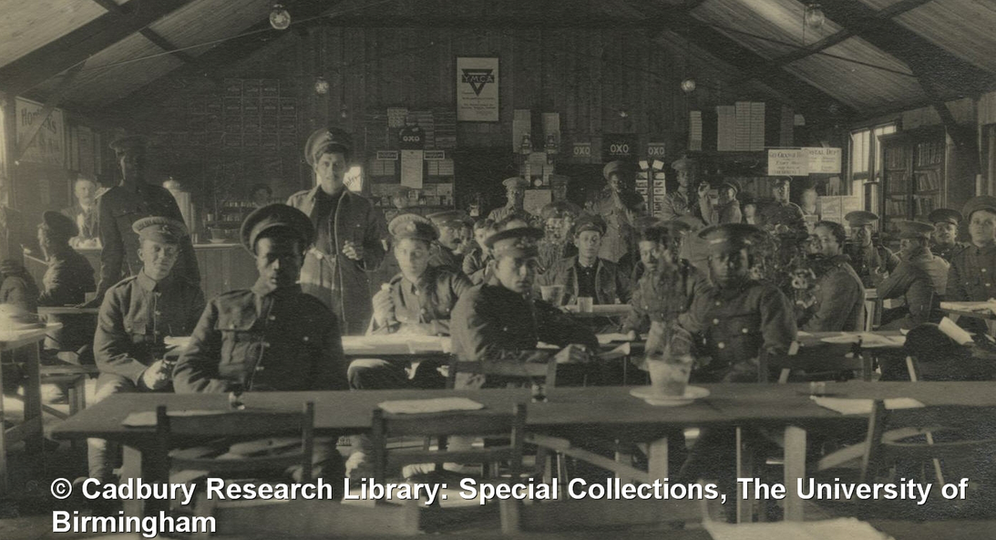
British West Indies Regiment at Seaford Camp
19 soldiers of the British West Indies Regiment are buried at Seaford Cemetery in East Sussex.
Hundreds of men from the Caribbean came to Britain wanting to serve in the British Army in the First World War.
The British West Indies Regiment was formed at Seaford in 1915 after the War Office agreed to let Black men join the army.
The conditions at the camp were very poor and most of the soldiers buried here died of illnesses such as mumps and influenza in the harsh winter of 1914- 1915.
There are two cousins from St Lucia buried here. Nelson and Dennis Fevrier have consecutive service numbers suggesting that they joined up together.
Notes:
Image: Cadbury Research Library, University of Birmingham – BWIR soldiers in the YMCA hut at Seaford Camp

Slide 3
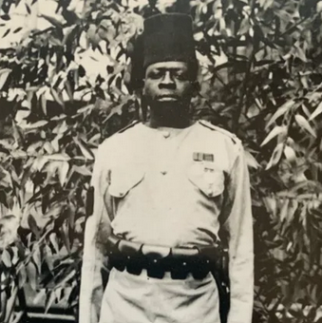
Regimental Serjeant Major George Williams
George Williams served in the King’s African Rifles during the First World War
He continuously proved his bravery in battle.
In 1915, in a battle at Jassin, on the borders of modern-day Tanzania and Kenya, he distinguished himself by going back under heavy fire to recover a machine gun after all the crew and porters had been killed.
He was recommended for the Victoria Cross for this action but never received it due to ongoing argument about whether Black servicemen could receive the honour.
He was, however, twice awarded the King’s African Rifles Distinguished Conduct Medal.
He was very well thought of by his commanding officers who commented that his name had been brought to notice for acts of gallantry four times in twelve months.
George was killed in action on 22nd July 1918 in Portuguese East Africa (now Mozambique) .
Notes:
Image Credit: Unknown – obtained at Rochdale Online

Slide 4
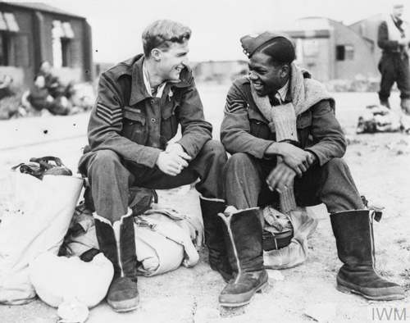
Sergeant Leslie Gilkes
Between 1940 and 1942, some 3,000 West Indians enlisted in the Royal Air Force. One of these volunteers was Leslie Francis Gilkes of Siparia, Trinidad.
He volunteered in 1942 and after training, joined Bomber Command flying in Lancaster bombers.
This photo was taken in 1943 showing Gilkes chatting with a Canadian crew member. Three days later, Leslie was dead.
On 3 August 1943, Leslie’s aircraft was shot down on the way back from a bombing raid on Hamburg, Germany. The plane crashed into the sea just off the coast of the Netherlands.
Sergeant Leslie Gilkes has no known grave as he was never recovered.
His name is inscribed on the CWGC Runnymede Memorial, alongside those of 20,000 other missing servicemen and women of Commonwealth air services.
Notes:
Photo credit: IWM
In October 1939 the British government announced that for the duration of the war the ‘colour bar’ preventing ‘those who are not of European descent’ from becoming officers in British forces would be removed. In November 1940, the Air Ministry informed the Colonial Office that it would accept black aircrew candidates from the colonies. People of colour who served in Britain faced discrimination and racist treatment, but units were not segregated - they flew, fought and lived with their white comrades.

Slide 5
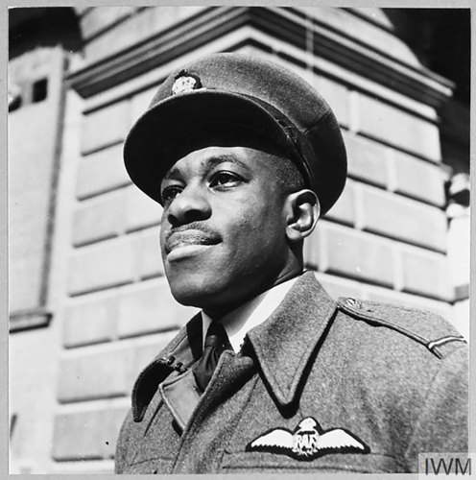
Flight Lieutenant Emmanuel Peter John Adeniyi Thomas
Peter Thomas came from Lagos in Nigeria to the UK to join the Royal Air Force, four months after the Air Ministry announced it would accept Black air crew.
In 1942 he became the first Black African to qualify as a pilot and the first to be commissioned as an officer.
He was a popular officer, liked by his comrades for his courtesy and good humour.
In January 1945, Peter was serving at the RAF’s No.4 Radio School at RAF Madley, helping to train wireless operators by taking them up to practice using equipment in the air.
On the 12th January, in bad weather, his plane crashed into the mountainside on a training exercise in South Wales.
Peter is buried in the CWGC plot at Bath Haycombe Cemetery, and his mother chose these very moving words to go on his headstone:
‘Forgive my grief for one removed, thy creature whom I found so fair.’ Mother.
Notes:
Image: Getty

Slide 6
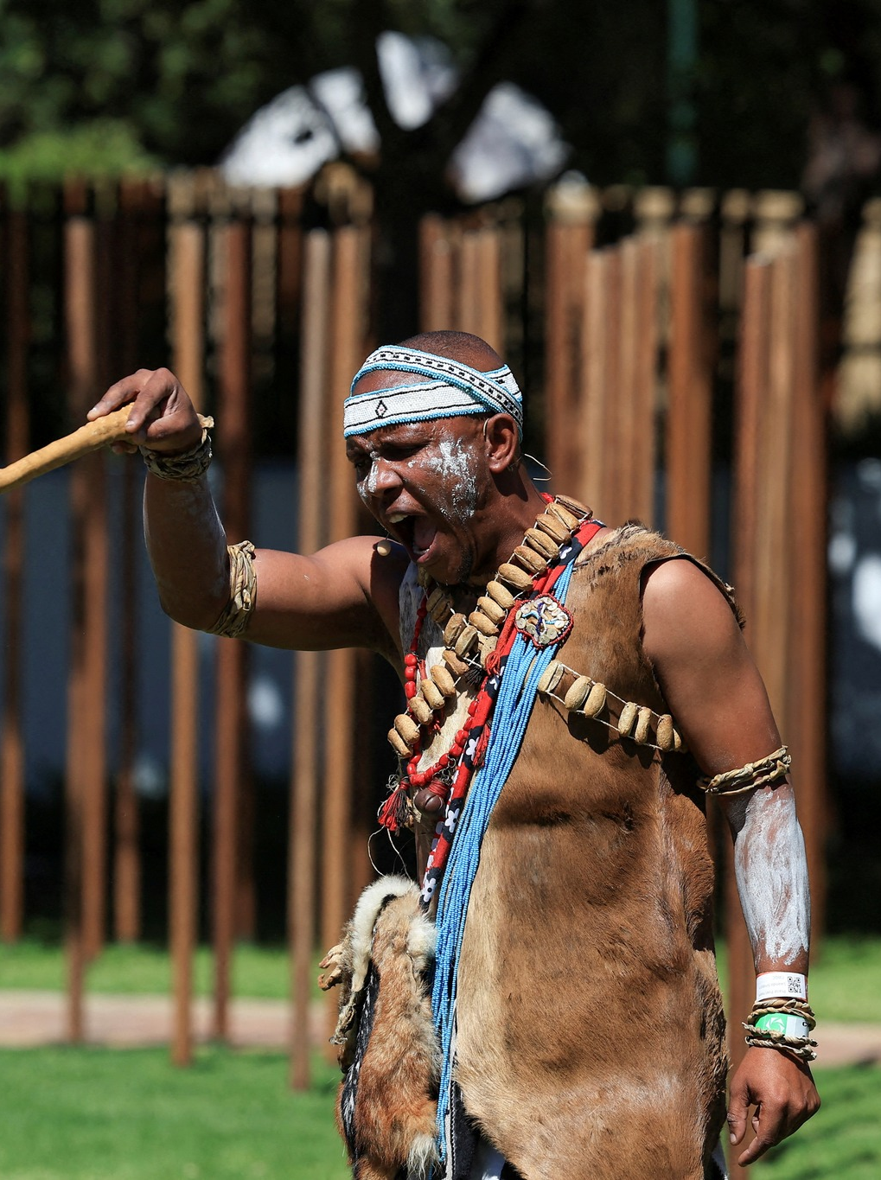
Cape Town Labour Corps Memorial
In January 2025, our newest memorial was unveiled in Cape Town, South Africa.
This memorial commemorates over 1,700 South Africans who served in the military labour corps and died during the First World War.
These men were previously unrecognised with no commemoration or known grave.
The labour units supported the British Army in the fighting in Africa, transporting supplies, building roads, loading and unloading ships and carrying the wounded as well as burying the dead.
Without them the army would not have been able to operate.
This new memorial recognises them by name on African hardwood posts.
It is one of the ways in which the CWGC are righting some of the historical wrongs of the past.
Notes:
Image: Getty

