Slide 1
Women in the Second World War
A CWGC education resource

Slide 2
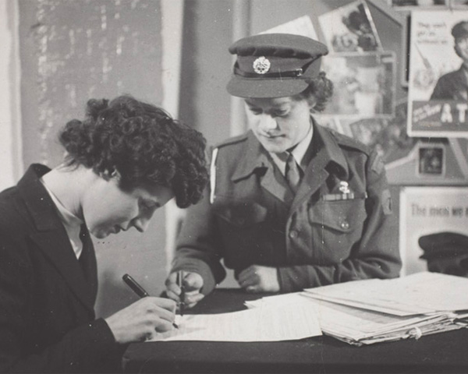
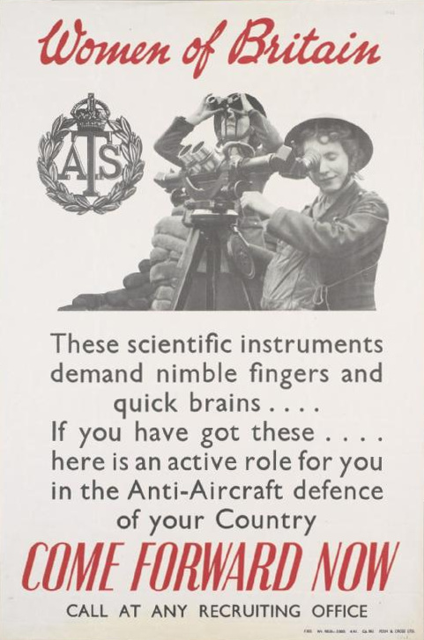
Women in the Second World War
The Commonwealth War Graves Commission commemorate around 3,600 women who died in both wars, with the majority of those dying during the Second World War.
From early 1941, all women aged 18 – 60 had to register for war work and from December 1941, women were conscripted in roles such as mechanics, munitions work, air raid wardens, bus drivers, farming or the armed forces.
At first, only single women between the ages of 20-30 were called up and given a choice between joining the armed forces or working in industry. This later changed to include women aged 19 - 43 as the need for the civilian population to help the war effort increased.
These women took over jobs that men had been doing in order to free up men for fighting. They were not allowed to carry or fire weapons, but the work they were doing was often dangerous.
By 1944 around 7 million women were engaged in war work.

Slide 3
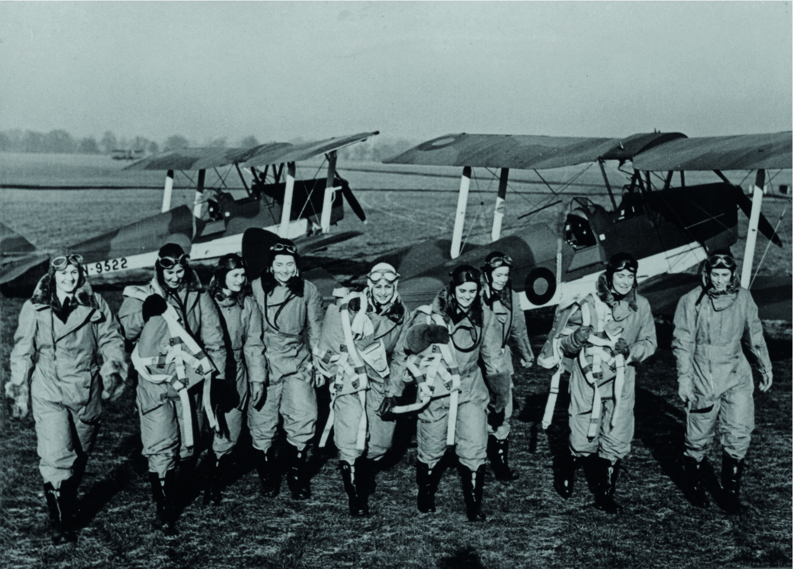
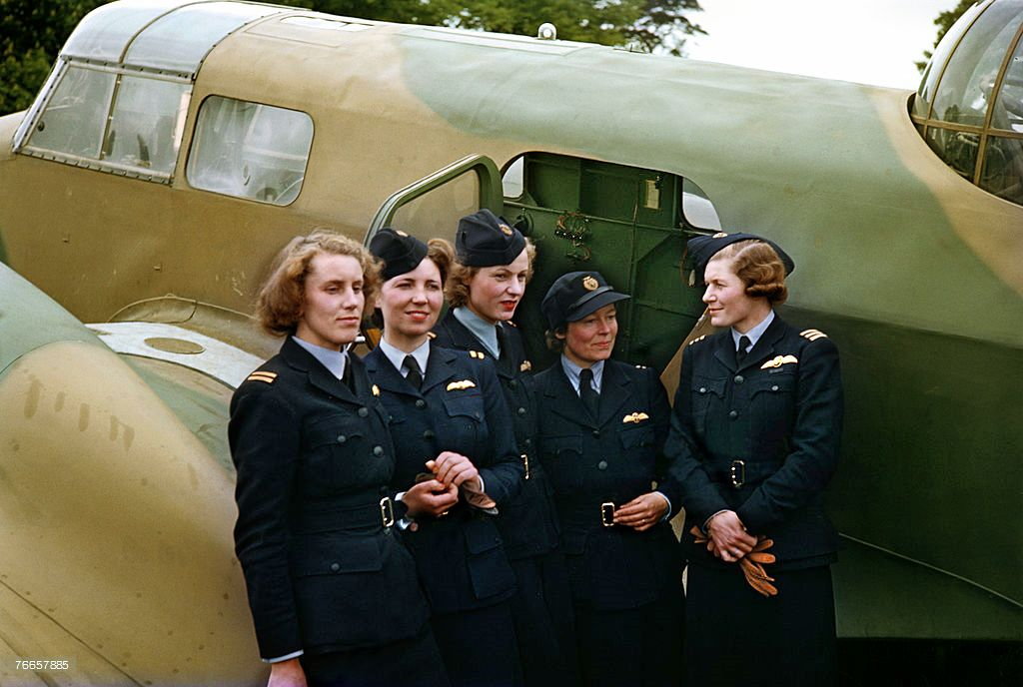
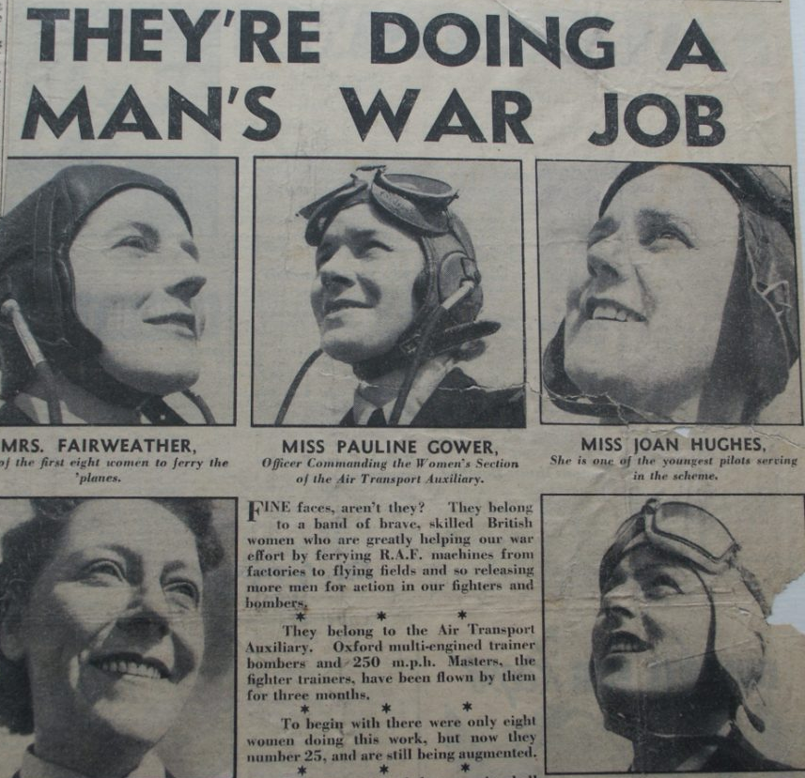
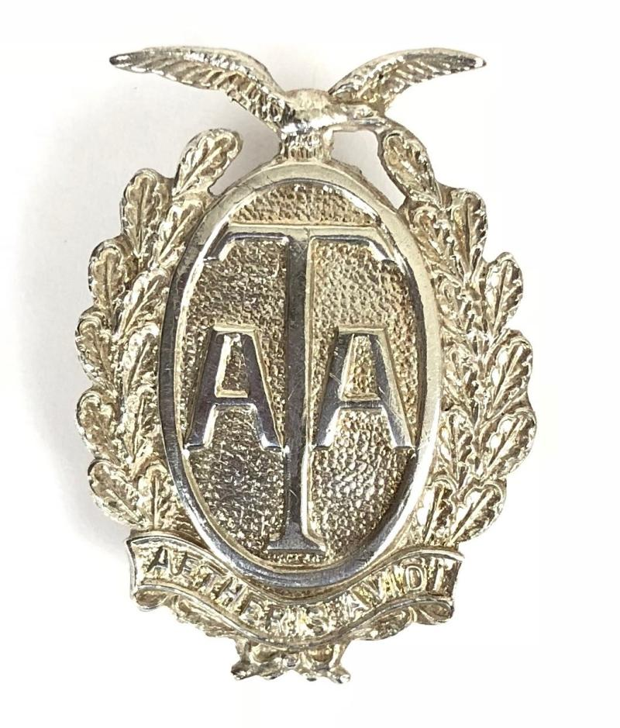
Key Facts – Air Transport Auxiliary
The Air Transport Auxiliary (ATA) was a civilian organisation set up during the Second World War. Its job was to take over from military pilots the task of ferrying Royal Air Force and Royal Navy planes between factories, maintenance units and airfields.
This vital work meant that military pilots could be freed up for combat roles and the RAF and the RN had the planes and equipment they needed in the right place at the right time.
The first eight women were accepted into the ATA on the 1st January 1940 and very quickly proved their worth.
Over time, 160 more women joined the ATA flying all sorts of aircraft: fighter planes like Hurricanes and Spitfires, through to big bombers such as the Lancaster.
Many of the women who joined had lots of flying experience from before the war. In many cases, more than the men of the ATA.
The ATA was the first organisation to pay female pilots the same as male pilots.
A

Slide 4
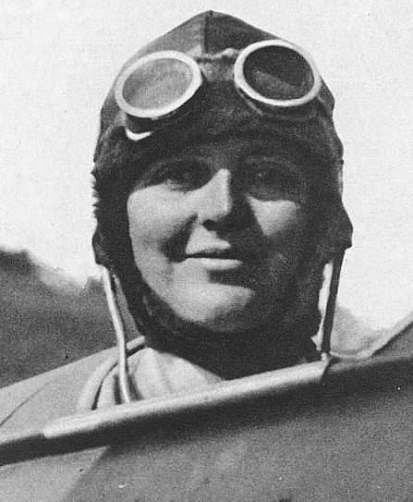
Flight Captain Eleanor Isabella (Susan) Slade
Susan Slade was one of the first women to join the Air Transport Auxiliary in 1940.
She was a pioneer of female aviation, flying in and winning many air races before the war. Susan owned several of her own aircraft and had already flown for around 550 hours before joining the ATA.
In the ATA, Susan ferried aircraft and service people around the country to where they were needed. She often did this on her own, unarmed, and without a map or radio.
On the 13th July 1944, Susan was transporting a Wellington bomber from a repair depot near RAF Little Rissington, Oxfordshire, when her plane crashed, and she was killed.
An eyewitness to the crash said, ‘One aeroplane seemed to be much lower than the others and was heading towards the village of Great Rissington, and in my opinion the pilot would have crashed into the village had she not swerved into the field to avoid crashing on to the houses.’
Susan Slade was 40 years old when she died.
She is buried at Stokenchurch Church Cemetery, Buckinghamshire.
Her parents asked for her headstone to be engraved with the words: DEATH HAVE I ORDAINED EVEN AS GLAD TIDINGS FOR THEE;WHEREFORE DOST THOU SORROW?
A.1
Notes:
Image: Catherine Beale/SWNS

Slide 5
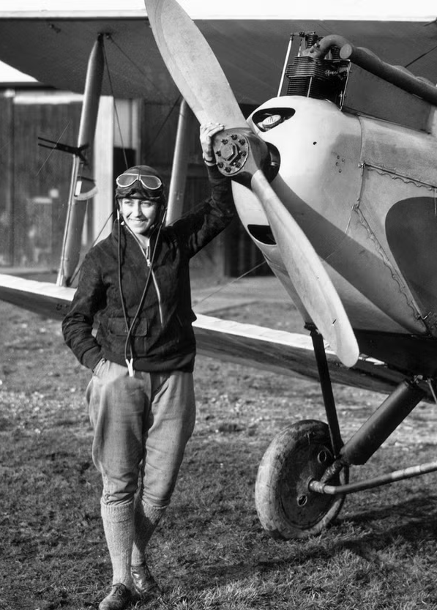
First Officer Amy Johnson
Amy Johnson was born in Hull, Yorkshire in 1903 and was introduced to flying in the 1920s as a hobby.
She was the first ever female pilot to fly solo the 11,000 miles from Britain to Australia, doing this in 19 days in 1930.
Amy set many other records for long distance flying and was very famous before the Second World War. She was known as the ‘Queen of the Air’.
When the war broke out, Amy used her flying experience to join the ATA and help ferry aircraft to where they were needed.
On the 5th January 1941, Amy was flying a plane from Scotland to Oxford when it is thought she went off course due to awful weather conditions. Possibly out of fuel, she bailed from her aircraft, parachuting into the sea near Herne Bay, Kent. Despite an attempt to rescue her from a nearby ship, Amy was never found.
Amy Johnson was 37 years old when she died.
She has no known grave and is commemorated on the Runnymede Memorial in Surrey. This memorial commemorates 20,000 members of the Air Forces who were never recovered after their deaths.
A.2
Notes:
Image: Getty

Slide 6
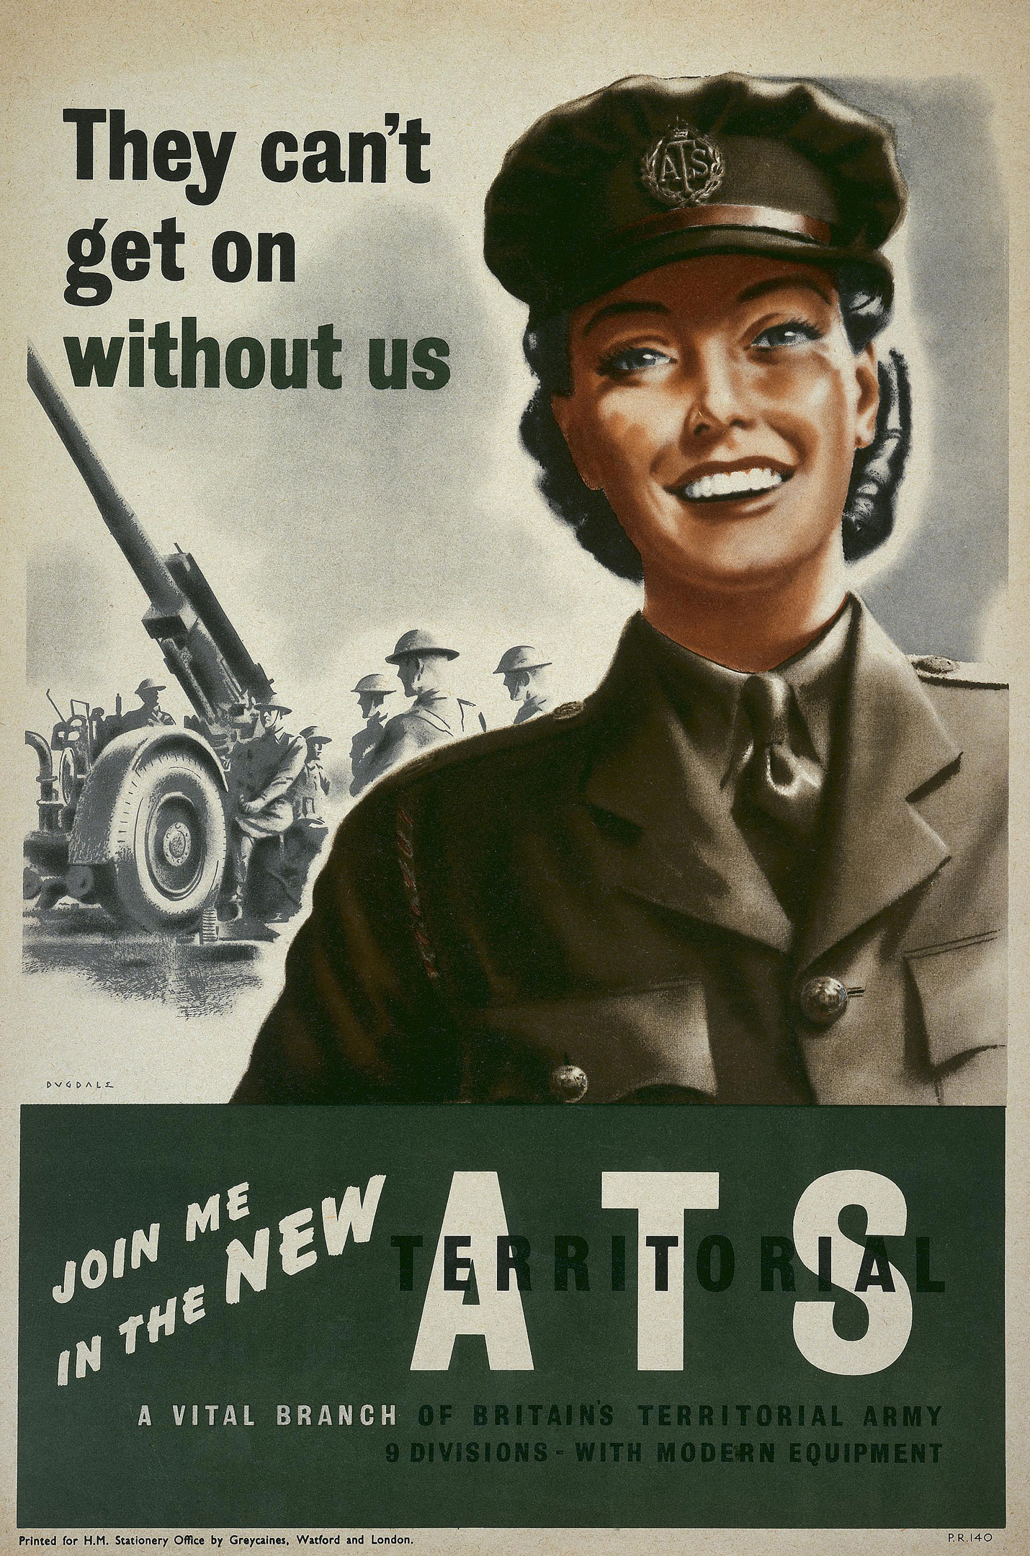
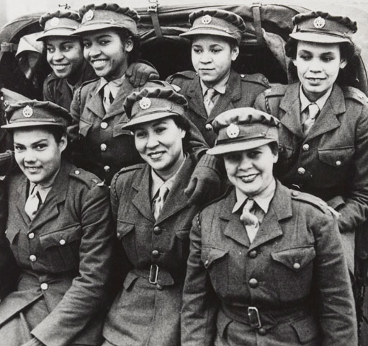
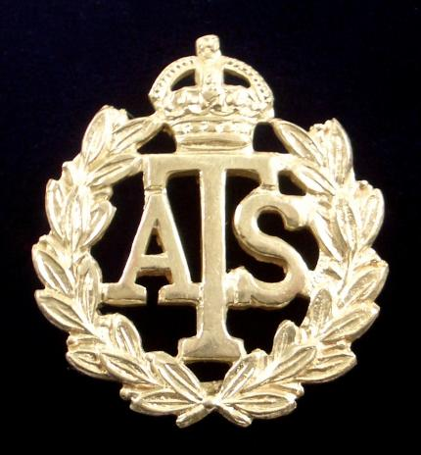
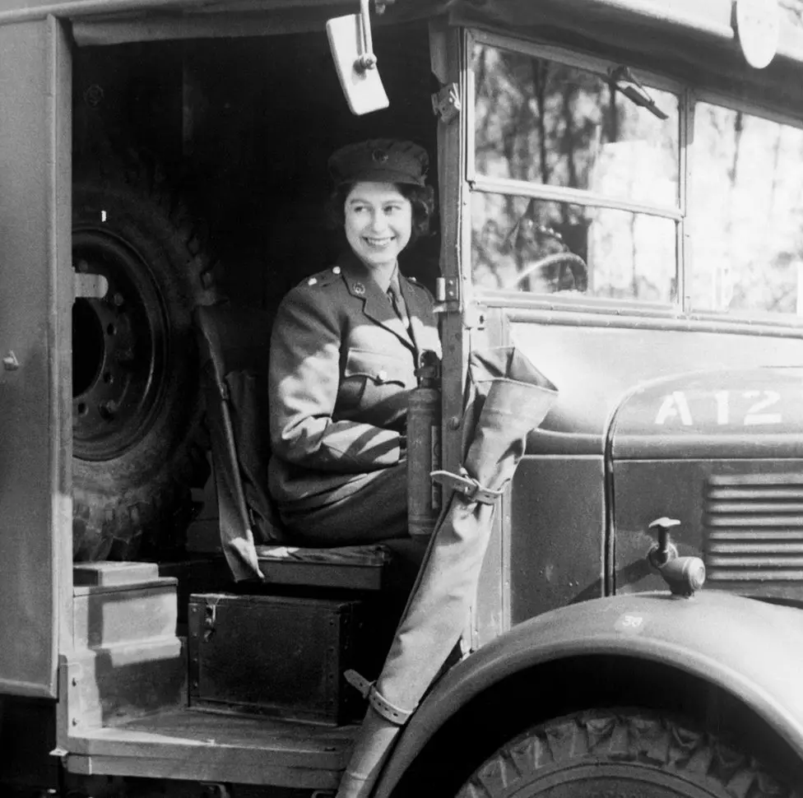
Key Facts – Auxiliary Territorial Service
The ATS was formed in 1938 and to begin with the only jobs available for women were very traditional ones such as cooks, waitresses, clerks, store women and orderlies.
Once the war began and more men were needed to fight this expanded to over 100 different job roles including: mechanics, drivers, military police, postal workers and radar operators.
Around 250,000 women served in the ATS during the Second World War.
Although they started working only on the home front, by the end of the war ATS women were serving all over the world.
Queen Elizabeth II joined the ATS in 1944 when she turned 18. She was the first female member of the Royal Family to become a full-time member of the armed services. She learned how to drive and maintain vehicles.
From 1943, Black women were allowed to enlist in the ATS and around 300 women served in the West Indian ATS, about a third of them in this country.
B

Slide 7
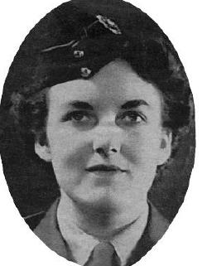
Corporal Enid Gertrude Line
Enid Line was from Crouch End in Middlesex and had worked at the Bank of England before the war.
Enid joined the Auxiliary Territorial Service in 1942 and was billeted at a house on the seafront in Great Yarmouth that housed ATS signallers. These were women working in communications.
On the 11th May 1943, the ATS women, including Enid, had been outside for a Physical Training exercise and had gone back into their house to change when it was hit by a German bomb. The air raid siren had not been sounded. The visibility was so hazy that morning, they hadn’t noticed the planes approaching until it was too late.
26 ATS women were killed in the attack, with most of them new recruits under the age of 25. This terrible incident was the single largest loss of British Army women during the war.
Eric Beckett, who was eight at the time, remembered in 2023 how he had met some of the ATS girls just days before the attack and said, ‘All we could hear was bombs going off. It was terrifying. It wasn't until a few days later that we realised that we'd seen the billet of the ATS girls we'd met being bombed. It was heartbreaking and I have never forgotten them, even after all these years.'
Enid Line was just 23 years old when she died.
She is buried at New Southgate Cemetery, Hertfordshire.
B.1
Notes:
Image: WRAC Association

Slide 8
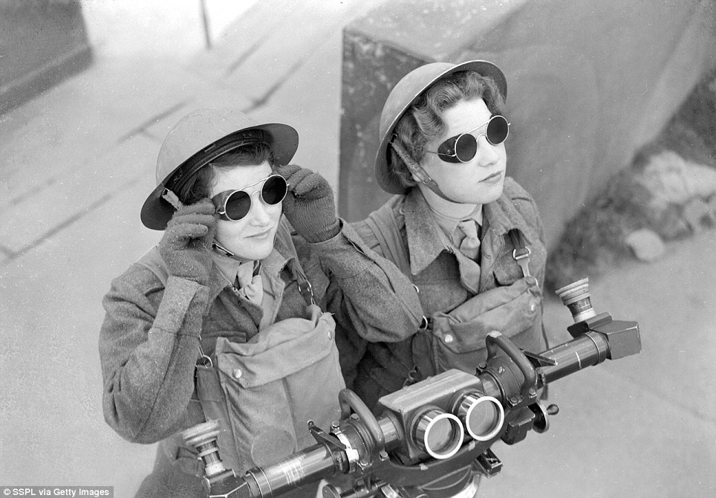
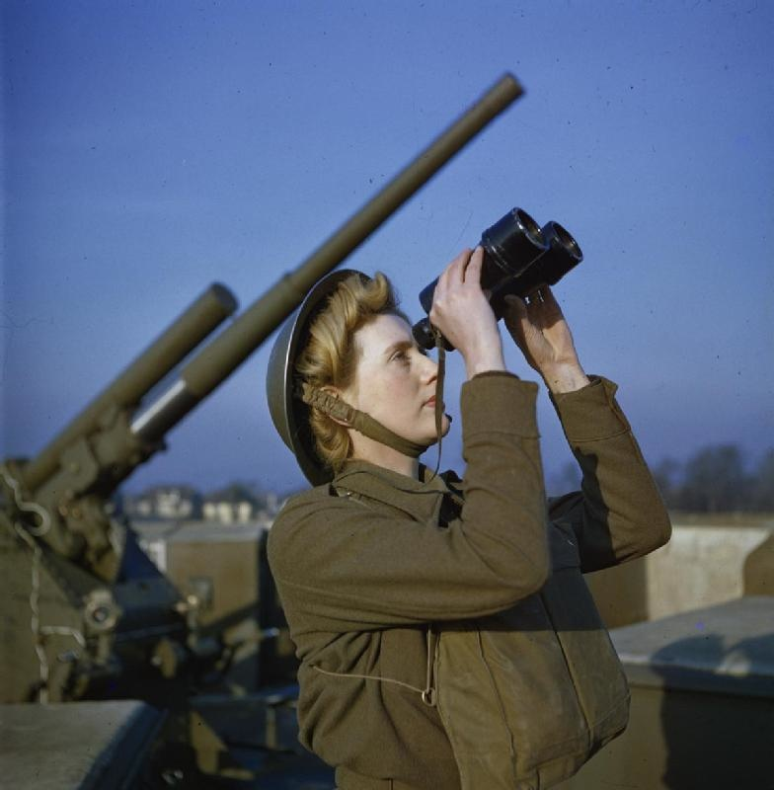
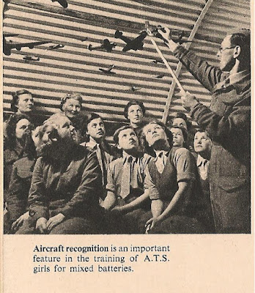
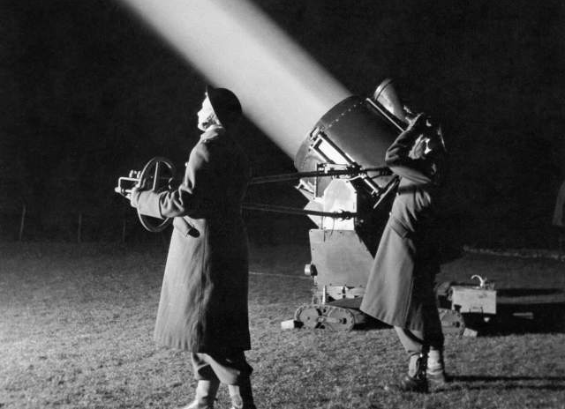
Key Facts – The Ack-Ack Girls
From 1941 a new job dangerous, for the women of the ATS – working in the anti-aircraft batteries, also known as ‘Ack-Ack’. These were set up around the country to try to intercept and destroy incoming enemy aircraft.
Women were not allowed to fire weapons, so they worked in mixed batteries. The women would work as spotters, predictors and operate height and range finders to identify enemy aircraft and give the men accurate details on where to aim their guns.
The government believed that women shouldn’t fire guns as it was not appropriate for ‘life givers to be life takers’.
Ack-Ack Girls were also trained to operate searchlights and had to wear special glasses to protect their eyes because the light was so bright.
The Ack-Ack Girls were highly trained and could pass on information within a matter of seconds, defending our skies against attack from the German Luftwaffe.
These jobs were very dangerous and many women were wounded or killed carrying out this vital defence of our country.
Ba

Slide 9
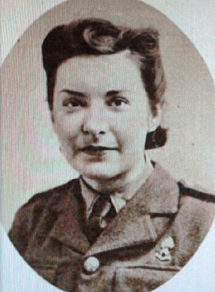
Private Nora Caveney
Nora Caveney was the first female member of the Auxiliary Territorial Service to be killed during the Second World War.
Nora was from Todmorden in West Yorkshire and before the war she worked in a silk factory as a bobbin winder.
Joining the ATS in 1941, Nora volunteered for Anti-Aircraft duties and was posted to one of the first mixed batteries working on front-line gun sites in the south of England. These women were known as ‘Ack-Ack Girls’.
On the evening of 17th April 1942, Nora was using a predictor to follow the course of an enemy plane when she was hit by a splinter of shrapnel from an exploding bomb and killed.
The other ATS girls continued with their important jobs throughout the rest of the raid which lasted nearly an hour. They were praised for how they dealt with the incident and Nora’s death. Their commanding officer said, ‘The girls’ discipline under fire is most praiseworthy. Seasoned soldiers could not have behaved better’.
Nora Caveney was just 18 years old when she died.
She is buried at Netley Military Cemetery, Hampshire.
The personal inscription on her headstone reads: RESTING WHERE NO SHADOWS FALL.
B.2
Notes:
Image Credit: Unknown – obtained at Rochdale Online

Slide 10
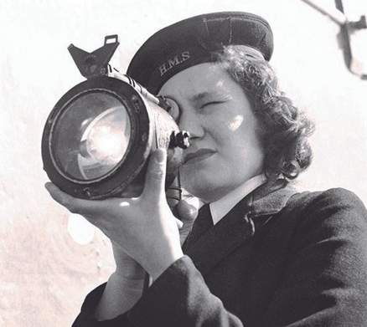
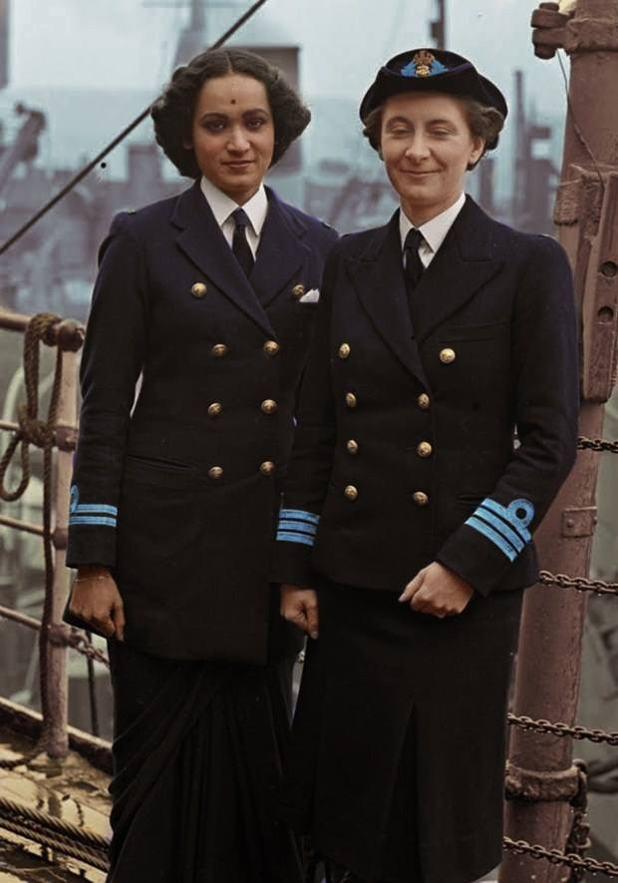
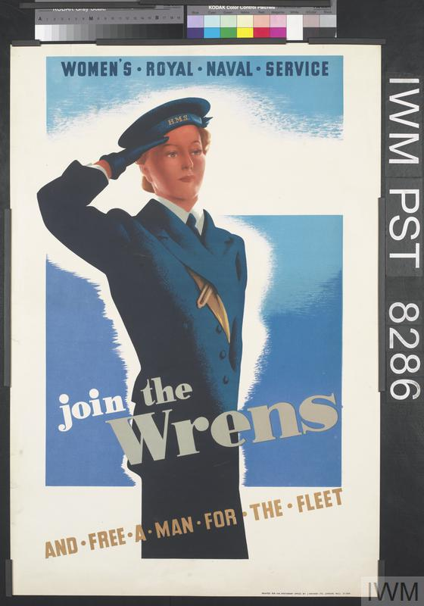
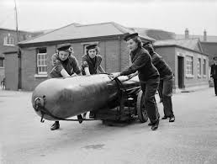
Key Facts – Women’s Royal Naval Service
The first women to serve in the Women’s Royal Naval Service (WRNS) had been during the First World War. The organisation was once again called into action as war approached in 1938.
As with the other women’s services, Wrens started out doing domestic and office duties but were soon being moved into a range of vital and dangerous jobs such as radio and radar operators, looking out for German U-boat signals and assisting with codebreaking at Bletchley Park.
The WRNS’ motto was ‘Never At Sea’ and to begin with most Wrens did not serve on ships, but towards the end of the war, some Wrens were trained to work on board ships.
During the Normandy Landings, many Wrens were involved in the behind the scenes planning for D-Day and some were even out in the Channel towing damaged boats back for repairs.
The Women’s Royal Indian Naval Service was formed in 1942 and by 1945 nearly two thirds of the women were Indian.
By the end of the Second World War, over 74,000 women had served in the WRNS doing over 200 different jobs.
C

Slide 11
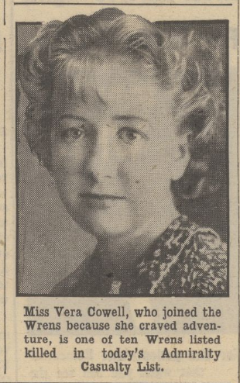
Wren Vera Margaret Cowle
Vera Cowle was from the Isle of Man and before the war she had worked serving in a radio shop on the island.
Soon after her 18th birthday, Vera joined the Women’s Royal Naval Service and was stationed at HMS Daedalus, a Royal Naval air base at Lee-on Solent. The Wrens lived in a former hotel near the base.
Vera worked as a Steward, serving in the base canteen.
She wrote to a friend saying how much she was enjoying her new life, ‘ I craved for adventure and I am sure getting it’.
On the 23rd March 1940, during the height of German air raids over Britain, the area was under heavy attack. Twenty-four Wrens were sitting down to their dinner, apparently rice pudding, when an anti-aircraft shell hit the dining room and ten of the women were killed and many others injured.
Vera was amongst those who was killed.
Her mother said in a newspaper report, ‘I am proud to think that my daughter died in the service of her country. Her father served in the last war and is doing his best as a coast watcher at this time’
Vera, who was just 18 when she died, is buried at Haslar Royal Naval Cemetery, alongside the other Wrens who died that night.
C.1
Notes:
Image Credit: Daily Mirror/BNA

Slide 12
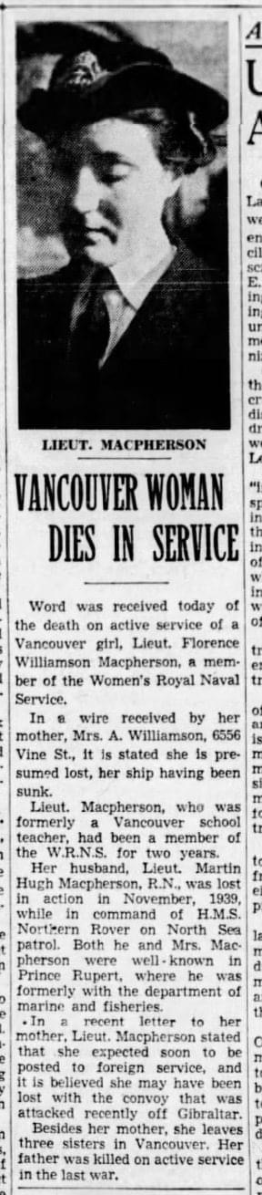
Third Officer Florence Macpherson
Florence was born in 1906 in Canada. She had lived in Vancouver, where she had been a school-teacher before the war.
When the Second World War came, Florence joined the Women’s Royal Naval Service (WRNS) and became a Cipher Officer in the highly secretive Y Service. Their job was to try and intercept secret messages and codes and work out where they were coming from and what they said. Florence’s work focused on messages from the German Navy.
In August 1941 she was among a group from the Scarborough station who departed from Liverpool aboard the SS Aguila. They had all volunteered to go closer to the dangers of war and were on their way to serve in Gibraltar.
The risk of attack from German U-boats meant that ships travelled in convoys. During their journey, the convoy was warned of long-range enemy aircraft and U-boats on their tail. They were told to expect an attack.
At 3am on 19 August two torpedoes struck Aguila. More than 400 people lost their lives. Florence and 20 other Wrens were among the dead.
Over the next four days nine more ships from the convoy were sunk. The Wrens and seamen lost at sea are all commemorated on our large naval memorials at Plymouth, Portsmouth and Chatham, and our merchant naval memorial at Tower Hill in London.
Florence, who was 35 when she died, is commemorated on the Portsmouth Naval Memorial.
C.2
Notes:
Image Credit: Unknown – obtained at cwgc.org

Slide 13
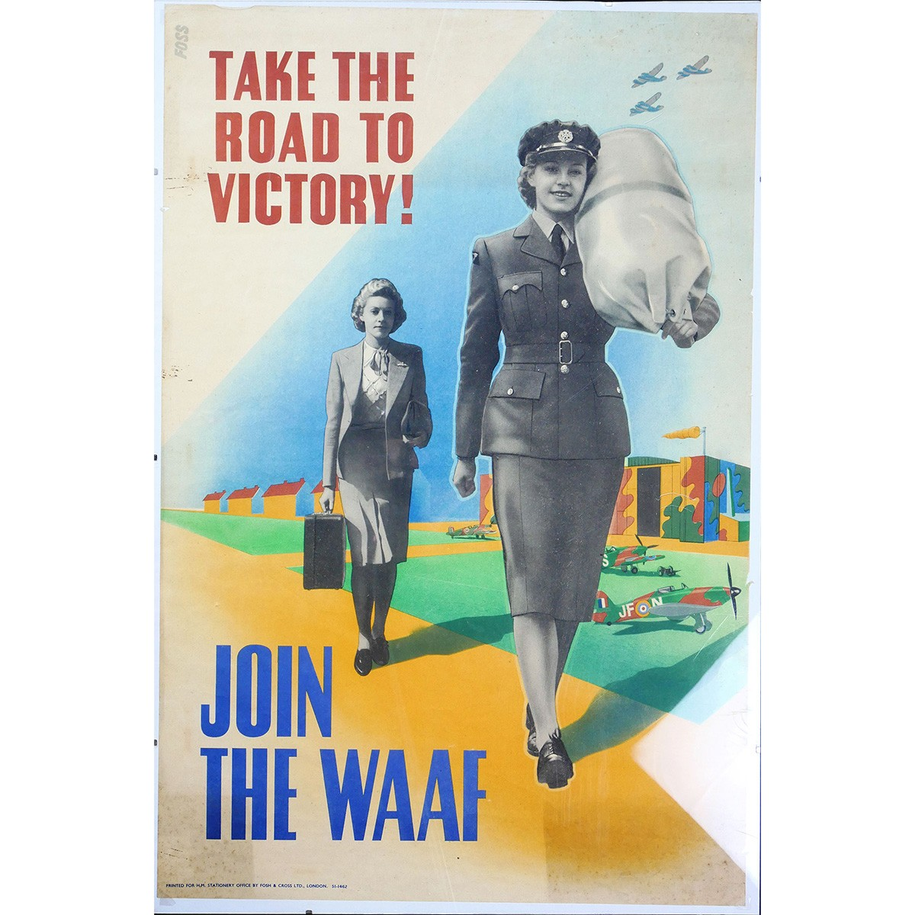
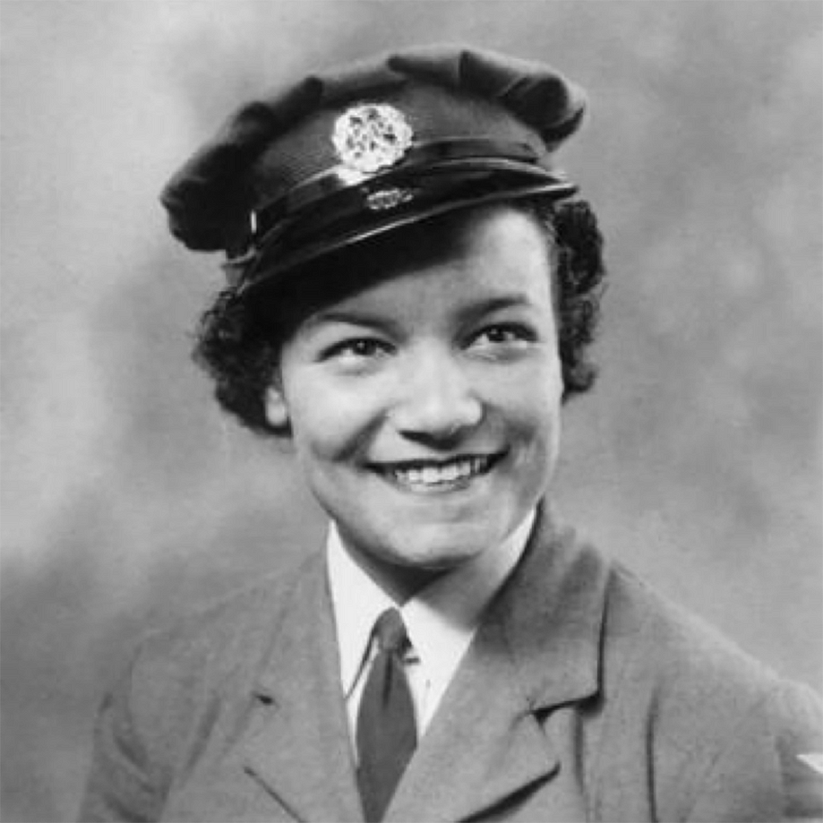
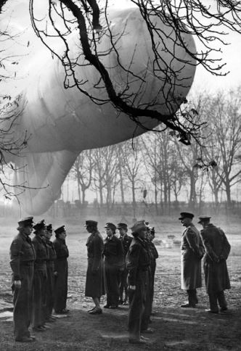
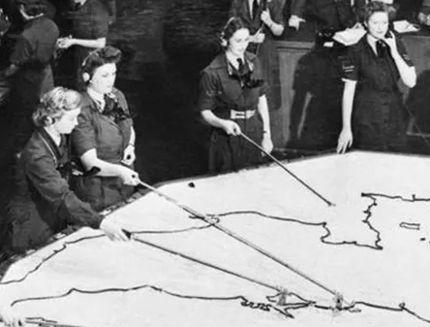
Key Facts – Women’s Auxiliary Air Force
The Women’s Auxiliary Air Force was created in 1939 to free the men of the Royal Air Force for front-line duties.
Women undertook many key roles in the WAAF: moving barrage balloons into position, writing weather reports, or working as flight mechanics and plotters tracking enemy aircraft.
Women from across the world came to join the WAAF – 48 different nationalities were represented.
Lilian Bader was one of the first black women to join the WAAF in 1941. She trained to become an instrument repairer, a trade that had only just become available for women.
Some women of the WAAF played an important role in wartime intelligence operations, working at Bletchley Park as codebreakers.
Many women were given medals for their bravery whilst serving in the WAAF for actions such as helping during air raids and rescuing pilots from their crashed planes.
By the end of the war around 250,000 women had served in the WAAF working in 110 different roles.
D

Slide 14
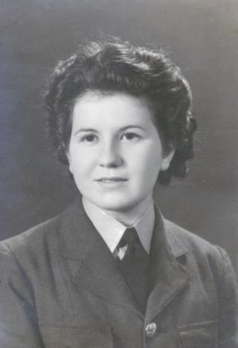
Leading Aircraftwoman Betty Mary Stannard
Betty Stannard was born on the 6th August 1921 in Benenden Kent, where she lived with her family until the Second World War broke out.
Betty enlisted in the Women’s Auxiliary Air Force and was posted to 953 Balloon Squadron in Cardiff. Barrage balloons played a vital part in the defence of Britain protecting towns and other important locations such as ports and factories.
Betty worked as a balloon operator which involved raising and lowering the balloons and transporting them to where they were needed.
On the 18th May 1943, Betty and the other women in her squadron were at their billet in Colchester Road, Cardiff, when an air raid began which carried on for nearly an hour.
At 3.10am the house received a direct hit from a bomb and Betty was killed along with two other balloon operators, Mary Askell and Paddy Brand.
Betty was only 21 years old when she was killed.
Betty was returned to her parents for burial in her home churchyard, St George’s, Benenden.
D.1
Notes:
Image Credit: Daily Mirror/BNA

Slide 15
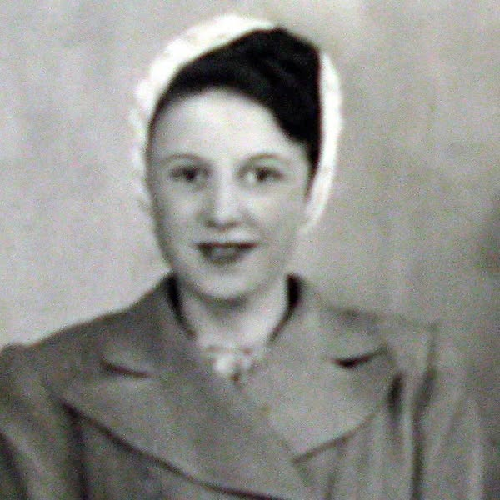
Aircraftwoman 2nd Class Jean Scargill
Jean Scargill was born in 1923 in Guisborough, Yorkshire.
Jean was working at Marston Moor air base in Yorkshire as a driver in the Women’s Auxiliary Air Force.
In January 1943, she had married Jeffrey Scargill who was serving in the Royal Artillery.
On the 8th July 1943, her truck was hit by a Halifax bomber, and she was killed. The plane was on a training flight and had misjudged its landing. Coming in too fast, the pilot overshot the runway and struck Jean’s truck.
Jean was just 20 years old and had only been married for 6 months.
She is buried in St Cuthbert’s Churchyard, Kirkleatham in Yorkshire.
The personal inscription on her headstone reads: KIND WERE HER WAYS, LOVED AND RESPECTED BY ALL; GOD GRANT HER ETERNAL REST. HER LOVING HUSBAND
D.2
Notes:
Image Credit: unknown

Slide 16
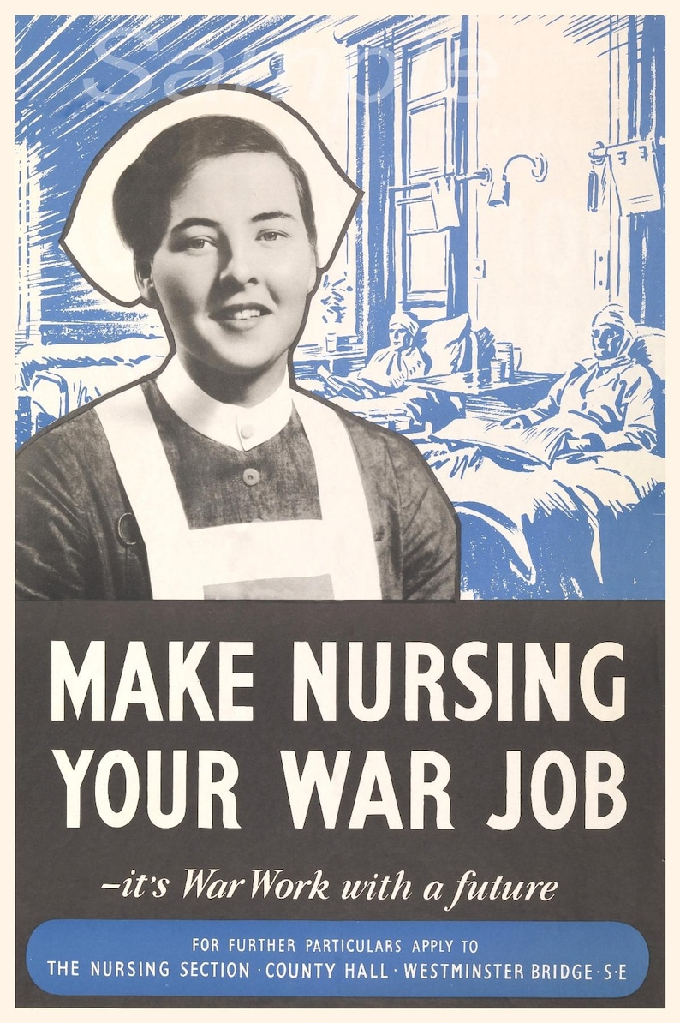
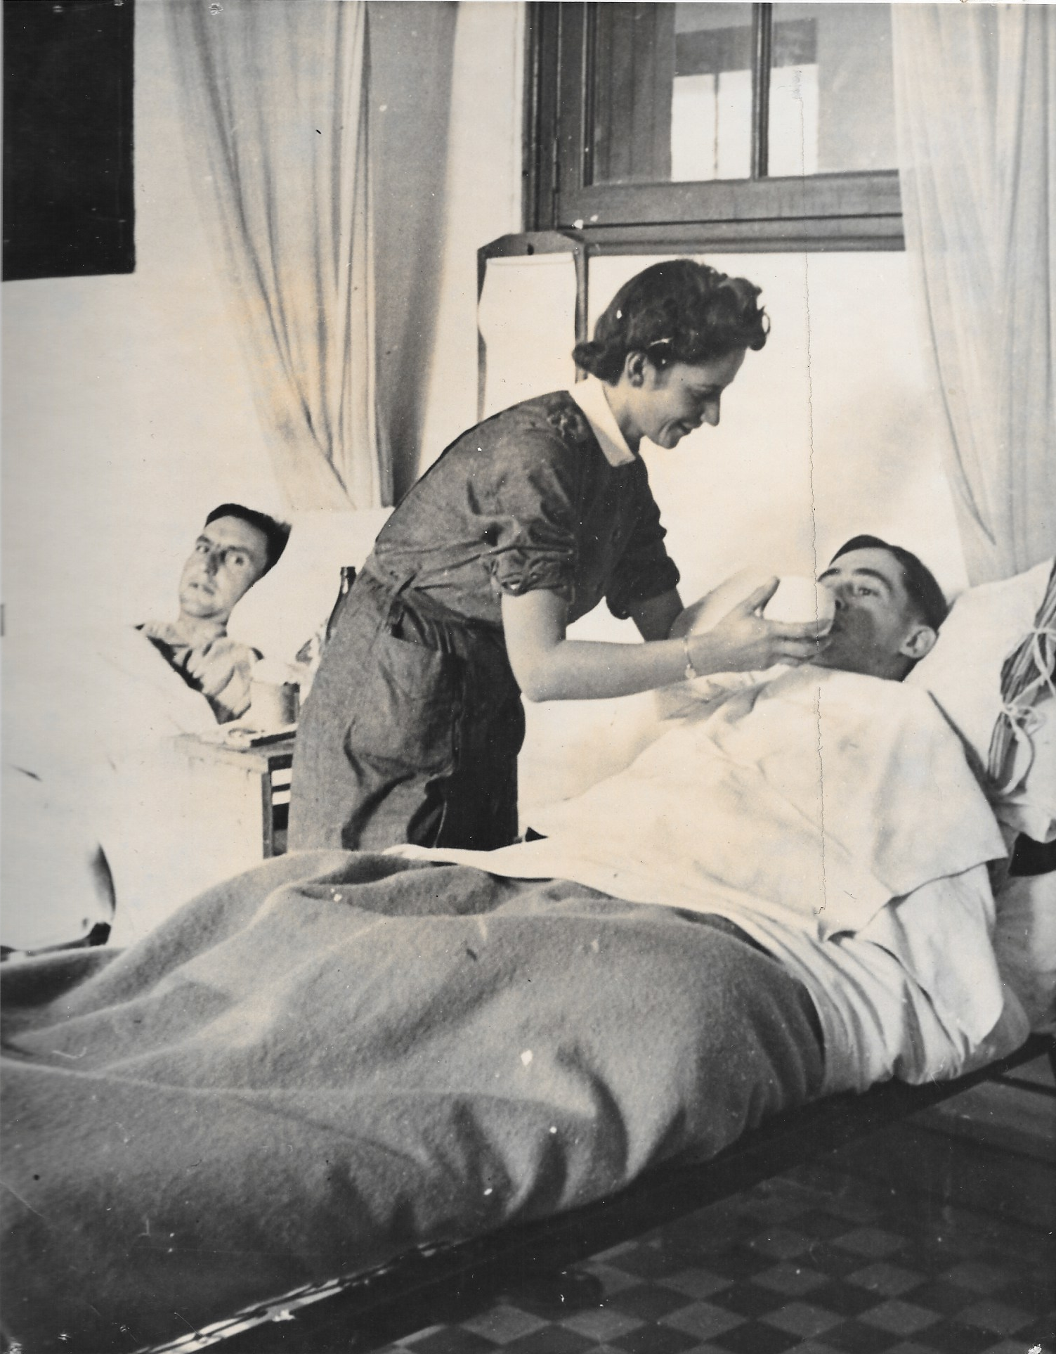
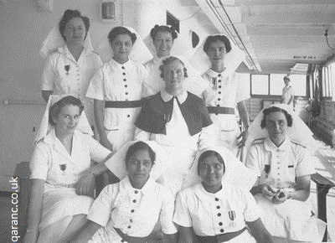
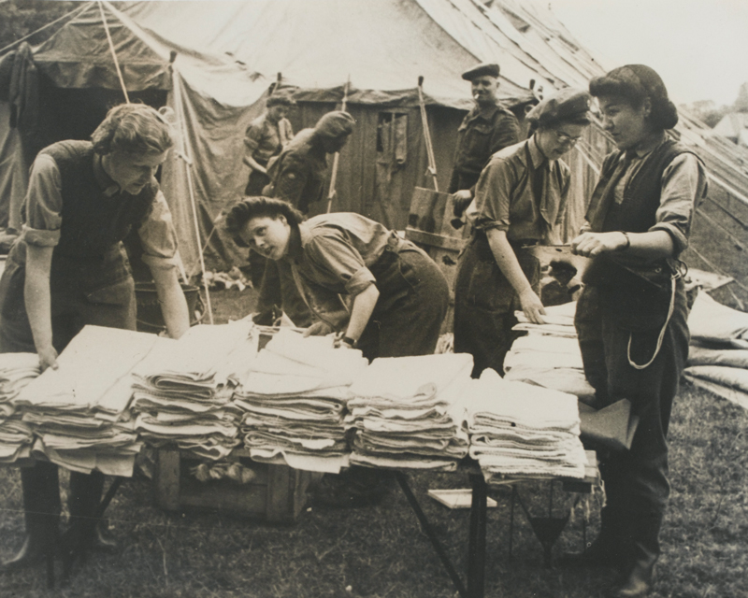
Key Facts – Nursing Services
There were many military nursing services in operation throughout the Second World War, caring for the sick and injured across the world. Several civilian services also worked alongside the armed forces.
Some of these groups were: Queen Alexandra’s Imperial Military Nursing Service (QAIMNS), the Voluntary Aid Detachment (VAD), specialist Air Force and Naval nursing units as well as units from the Commonwealth countries such as Canada, Australia and India.
These women often found themselves in very dangerous situations close to the front-lines and at risk from air raids, the ships they were travelling on being torpedoed, or being taken as a prisoner of war.
The conditions they lived and worked in were often difficult. Food was scarce, the hours were long and they were often having to deal with terrible war injuries and traumatised men.
In 1944, QAIMNS nurses were the first women to arrive in Normandy to set up a general hospital to deal with casualties from the D-Day Campaign.
E

Slide 17
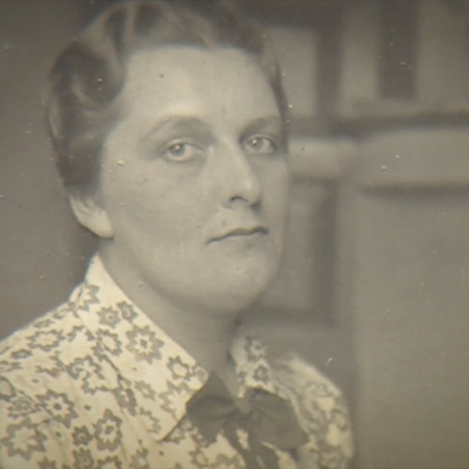
Sister Dorothy Anyta Field
Dorothy was born in Surrey in 1912. She trained as a nurse in London, qualifying in 1935.
When war broke out, Dorothy joined the Queen Alexandra’s Imperial Nursing Service caring for wounded service people.
By 1944, Dorothy was serving on the SS Amsterdam. This ship had been part of the D-Day landings before being converted into a hospital ship to bring casualties of the Normandy Campaign back to Britain for treatment.
On the 7th August, the ship was just off Juno Beach when it struck a mine, causing a massive explosion.
With the ship sinking, lifeboats were launched, and Dorothy had reached one safely, but returned below deck and helped to bring seventy-five injured soldiers up to safety.
Dorothy was still below deck when the ship finally sank and was never recovered.
Dorothy was awarded the Kings’ Commendation for Brave Conduct and Mentioned in Despatches after people learnt of her brave actions on that day. The men saved also wrote letters to her parents to show their gratitude for her bravery.
Dorothy was 32 years old when she died. As she was lost at sea, her name is commemorated on the Bayeux Memorial, France.
E.1
Notes:
Image Credit: Unknown but located at Remember the Fallen

Slide 18
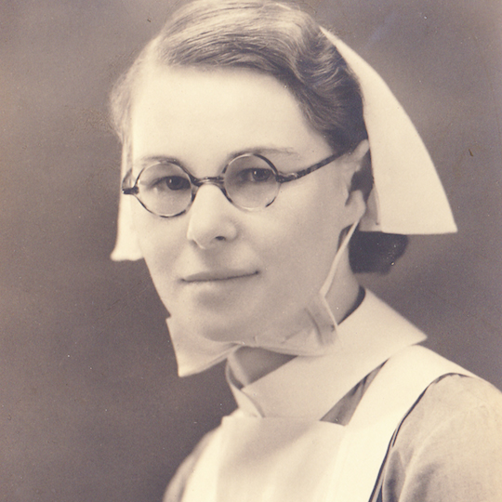
Sister Mollie Evershed
Mollie was born in Sussex in 1915, and after school, qualified as a nurse in 1936.
Her school magazine described her as, ‘Practical, steady, and reliable, Mollie was always eager to help in any way. She was energetic, lively, full of fun and friendly and popular with everyone in the school, both staff and girls.’
When war broke out, Mollie joined the Queen Alexandra’s Imperial Nursing Service caring for wounded service people.
By 1944, Mollie was serving on the SS Amsterdam. This ship had been part of the D-Day landings before being converted into a hospital ship to bring casualties of the Normandy Campaign back to Britain for treatment.
On the 7th August, the ship was just off Juno Beach when it struck a mine, causing a massive explosion. With the ship sinking, lifeboats were launched, but instead of making her way to safety, Mollie returned below deck and helped to bring seventy-five injured soldiers up to safety. She was still below deck when the ship finally sank, and she was never recovered.
Mollie was, said the captain later, ‘the bravest woman I have ever known’. In recognition of this bravery, Mollie was awarded the Kings’ Commendation for Brave Conduct and Mentioned in Despatches after people learnt of her brave actions on that day.
Mollie was 27 years old when she died. As she was lost at sea, her name is commemorated on the Bayeux Memorial, France.
E.2
Notes:
Image Credit: Christine Cranfield

Slide 19
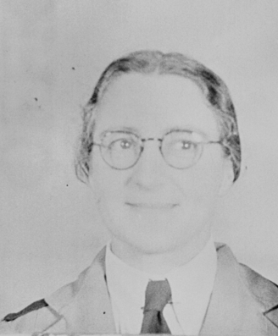
Sister Pearl Beatrice Mittelheuser
Pearl was born in 1904 in Bundaberg, Queensland in Australia. She joined the Australian Army Nursing Service and served in the Far East.
Pearl was among the last 65 Australian nurses to be evacuated from Singapore on board the ship, SS Vyner Brooke. However, on the 14th February 1942, the ship was bombed by Japanese aircraft and sank.
Many people died during the attack, but Pearl and many of the nurses were able to make it to shore at Banka Island. Unfortunately, the island was already occupied by the Japanese and most of the nurses were rounded up and taken prisoner.
Pearl and the remaining Australian nurses were moved around a series of prisoner of war camps over the next three years.
Conditions in the camps were terrible: food and medicine was scarce, the living conditions were awful, with leaking bamboo huts and muddy floors. Diseases spread quickly through the women in these conditions and many more died of starvation and illnesses.
On the 15th August 1945, the Japanese surrendered, finally bringing the Second World War to an end. It was too late for Pearl, sadly. She died three days later on the 18th August at the age of 41.
Pearl is buried at Jakarta War Cemetery in Indonesia.
E.3
Notes:
Image: Credit: AWM

Slide 20
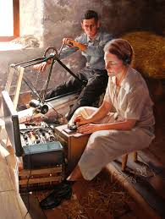
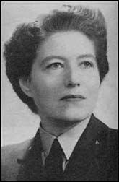
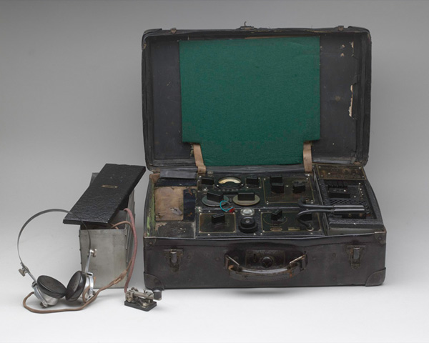
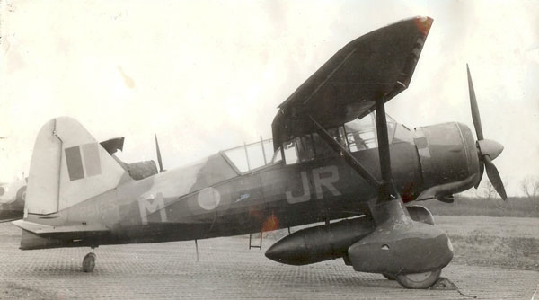
Key Facts – Special Operations Executive & Resistance Groups
Formed in 1940, the Special Operations Executive was a secret organisation set up to carry out sabotage and encourage resistance behind enemy lines across Europe and Asia.
They were supported by Churchill who encouraged them to, ‘Set Europe ablaze’.
SOE agents were often parachuted into the occupied country with secret radio transmitters designed to look like suitcases, fake papers and money.
Once there they would set up secret networks of contacts and work with local resistance groups with the aim of sabotage: blowing up trains, bridges and factories
39 women were recruited into the SOE F (French) Section. It was thought that women could travel around more easily without people becoming suspicious. 15 of these women lost their lives.
There were many resistance groups around the world working to undermine the plans of the Axis powers. The men and women who joined these groups were very brave. This work was incredibly dangerous. If discovered, agents risked torture and death.
F

Slide 21
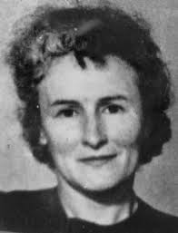
Ensign Yvonne Claire Rudellat
Yvonne was born on the 11th January 1897, in Maisons-Lafitte, near Paris, France. When her father died, she moved with her mother to London.
Yvonne was desperate to do something to help France, which was now occupied by the Germans, and talked about this to everyone she met. She came to the attention of the SOE recruiting officer and after passing the initial training and selection process she was accepted in May of 1942.
Yvonne became the first woman SOE sent into France, arriving by boat on the 30th July 1942.
There she successfully operated under her code name, Jacqueline, as a courier, organising resistance activities, managing drop zones for agents and supplies and carrying out acts of sabotage, including blowing up trains.
However, in June 1943, Yvonne was injured and then arrested whilst on a mission to collect two Canadian agents who had been parachuted into France.
Yvonne never fully recovered from the injury she had received, and her health got worse and worse whilst she was in prison.
She died, aged 48, in the Bergen-Belsen concentration camp of illness just shortly after the camp was liberated.
Her burial place was not known, and she is commemorated on the Brookwood Memorial to the Missing in Surrey.
F.1
Notes:
Photo credit – Public Domain

Slide 22
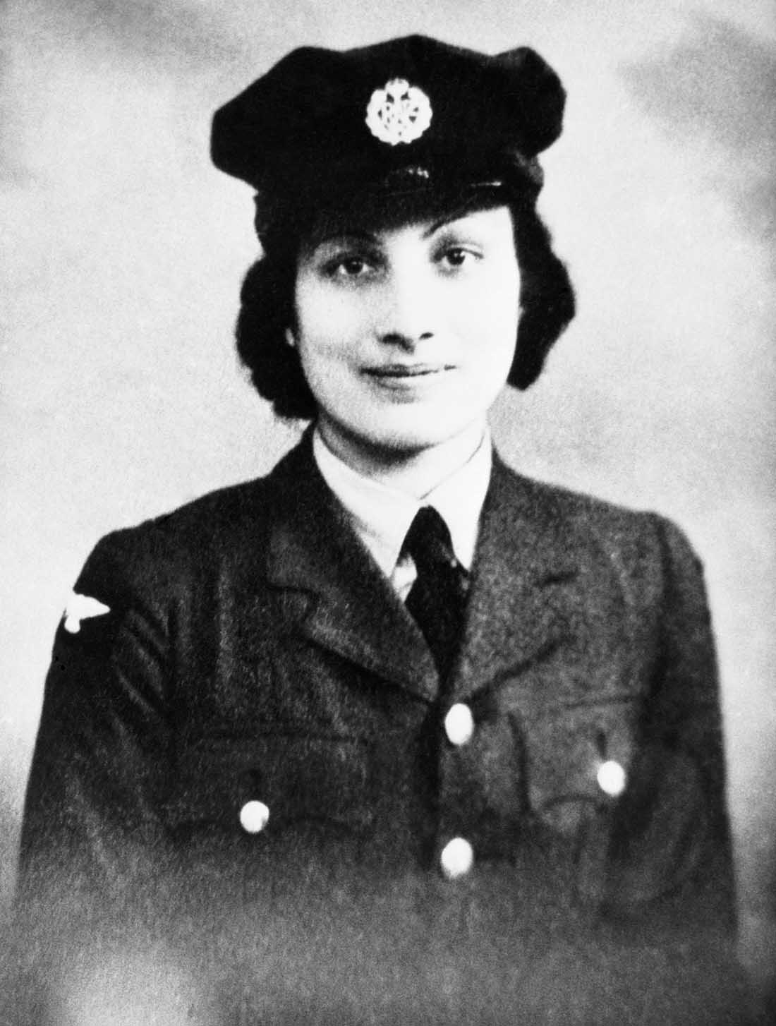
Section Officer Noor Inayat Khan
Noor was born on the 1st January 1914, in Moscow to Indian and American parents. The family moved around a lot, living in London for a while before settling in France.
Despite being raised as a pacifist, Noor joined the Women’s Auxiliary Air Force in 1940, where she was trained as a wireless operator.
Noor spoke fluent French and so came to the attention of SOE in 1943. Desperate for wireless operators, Noor was sent into France before completing her training and made her way to Paris.
Some of her instructors weren’t sure that Noor would make a good agent. One report about her in training said that she ‘always volunteers too much information when being questioned’. But she was a wireless operator, and this skill was desperately needed in France.
Noor was sent into France and worked undercover in Paris under her codename Madeleine, before being betrayed to the Germans. She was interrogated and sent to prison.
On the 12th September 1944, Noor, along with three other SOE female agents were sent to Dachau Concentration Camp where they were shot. Noor was 30 years old.
Noor has no known grave and is commemorated on the Runnymede Air Forces Memorial in Surrey.
F.2
Notes:
Photo credit – IWM

Slide 23
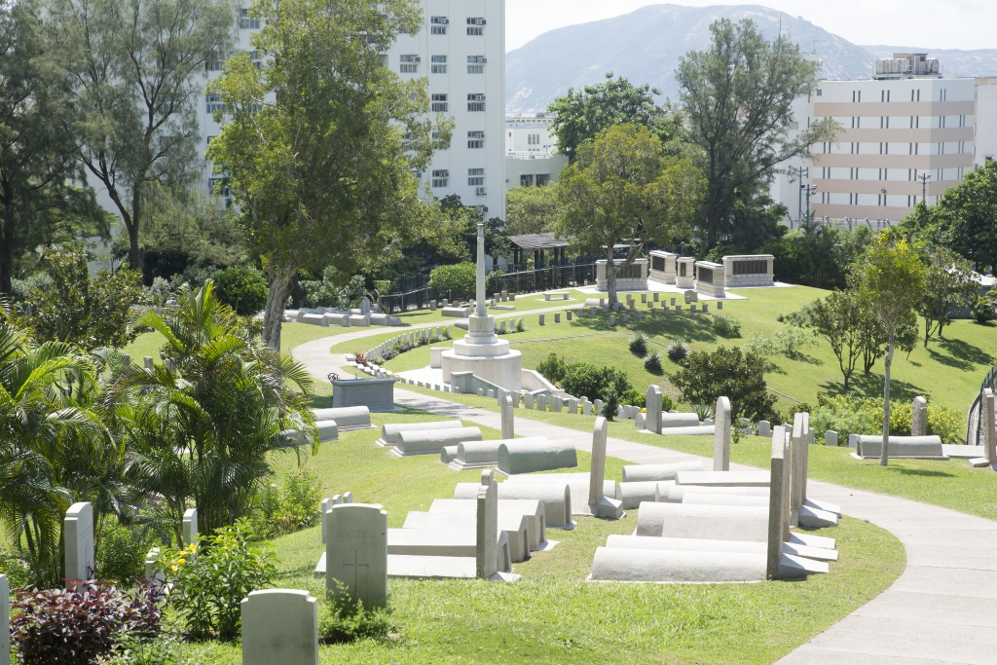
Volunteer Lau Tak Oi
Little is known about the early life of Lau Tak Oi before the Second World War. She lived in Hong Kong, which was at that time a British colony, and was a nurse and midwife. She was married to Loie Fook Wing.
When Hong Kong was captured by the Japanese, Lau Tak Oi became part of a group called the British Army Aid Group through her husband’s role in the Hong Kong police force.
The British Army Aid Group was one of the resistance organisations in Hong Kong and their role was to gather intelligence, help people escape from Japanese captivity and provide food , medicine and messages of encouragement to the people of Hong Kong.
Over the course of the war, the British and Chinese worked alongside each other to help around 2000 people escape.
In the summer of 1943, Lau Tak Oi, her husband and brother were all arrested and sent to prison. They were interrogated about their activities and treated very badly.
On 29th October 1943, Lau Tak Oi was the only woman of 33 British Army Aid Group volunteers who were put to death.
She is buried in Stanley Military Cemetery, Hong Kong, China.
F.3
Notes:
Photo credit – CWGC Stanley Military Cemetery Hong Kong

Slide 24
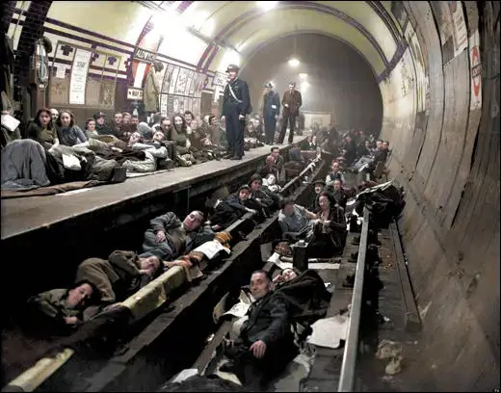
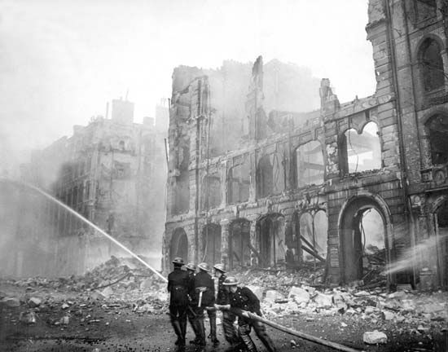
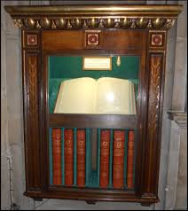
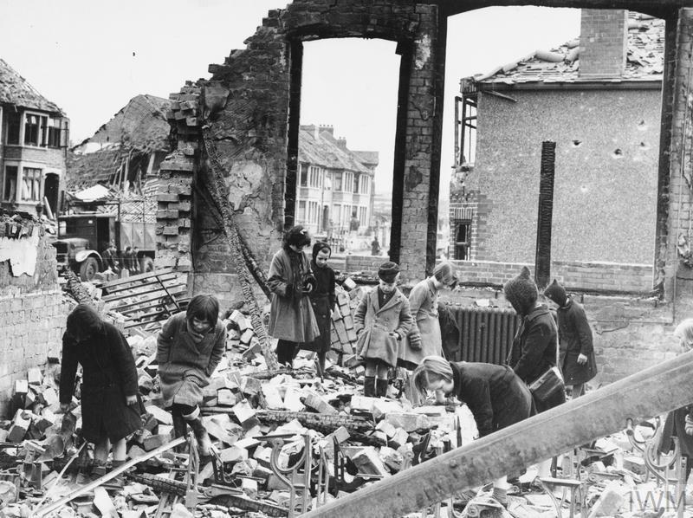
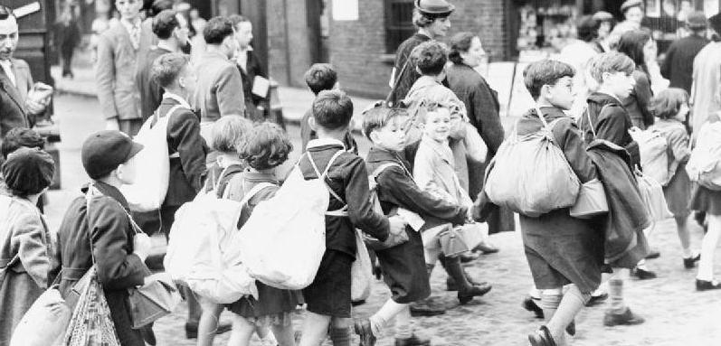
Key Facts – Civilian War Dead
One of the duties of the Commonwealth War Graves Commission during the Second World War was to collect and record the names of civilians who died as a result of enemy action.
Most of these men, women and children died in the many air raids that Britain suffered in the war years, especially during The Blitz which affected towns and cities across the country.
Around 67,000 people, of all ages, are remembered on the Civilian Roll of Honour which is kept in Westminster Abbey in seven big books of names.
G

Slide 25
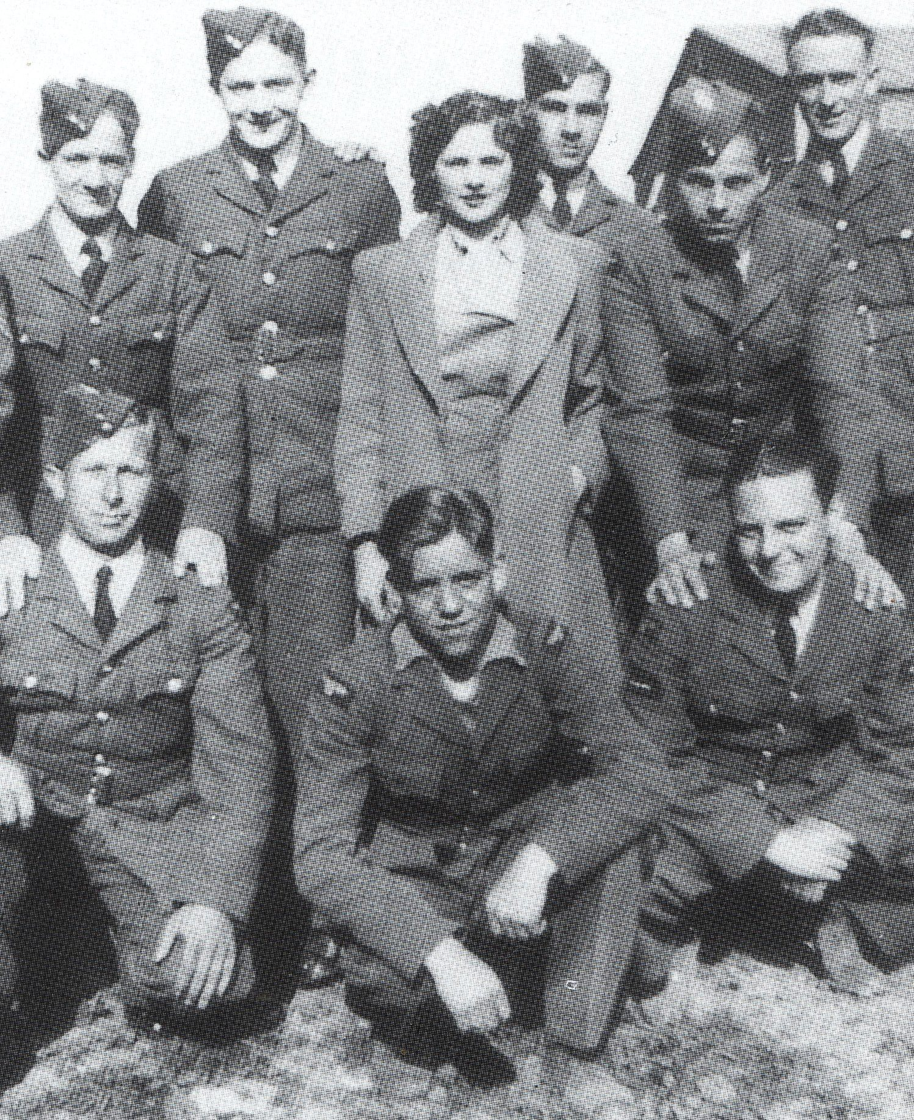
Mary Cremin
Mary Cremin was from Cork, Ireland.
Mary was working in the NAAFI (Navy, Army & Airforce Institute), an organisation that provided entertainment facilities, canteens and shops for service people both here and abroad.
During the Battle of Britain in 1940, there were many German air raids on RAF bases with the intention of causing damage to our planes and equipment.
One of these raids took place on the 30th August 1940 at Biggin Hill airfield. The damage caused by the nine German planes was terrible and resulted in 39 deaths.
Mary, who was known as ‘Trixie’ on the base, had been working in the stores at the airfield when the air raid happened. She had run back to the stores to get some cigarettes for ‘the boys’ when she was killed.
Mary was just 24 years old when she died.
She is buried at Orpington Cemetery, Kent.
G.1
Notes:
Photo credit: unknown

Slide 26

Joan Taylor
Joan Taylor had lived with her aunt and uncle since her mother died when she was three.
She had two brothers, William and Earnest, who were serving abroad.
Joan was employed in the shoe department of Gillingham Co-Op and regularly attended local bible classes.
On 6th June 1944, in the early hours of the morning, Joan’s house in Corporation Road, Gillingham, was destroyed by an American B26 Marauder bomber that had just suffered a mid-air collision with another plane.
Both Joan, who was only 18 years old and her Aunt Fanny, who was 60 years old, died in this accident. They had been asleep in their beds when the plane crashed onto their house.
Joan, and the other three victims of this crash, are buried at Woodlands Cemetery, Gillingham.
G.2
Notes:
Photo credit – Bryan Jones & Taylor Family

