Slide 1
First World War Poetry in Context
Exploring poetry and experience
A CWGC education resource

Slide 2
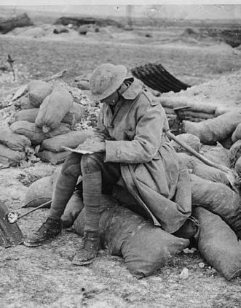
Comparing how writers during the First World War explore their personal experiences of conflict
The Commonwealth War Graves Commission has many links to poetry, not only in the great war poets who are buried or commemorated at our various cemeteries and memorials around the world, but also in the use of poetry and verse within the very fabric of some of those sites.
This teaching resource encourages students to explore and compare the experiences of war in a selection of the poetry of the First World War.
Each poem has been written by, or has a close connection to, casualties we commemorate who lost their lives in the war.
The resource will allow for the teaching of the key English skills of understanding themes and ideas, language analysis, looking at texts in their context and comparison.

Slide 3
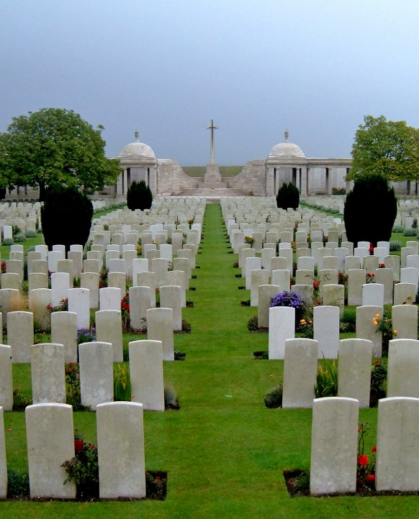
Who are the Commonwealth War Graves Commission?
We commemorate more than 1.7 million men and women who died in the First and Second World Wars from across the Commonwealth.
We do this by:
keeping records of those who died
making sure every individual is remembered by name on a headstone or memorial
sharing their stories

Slide 4
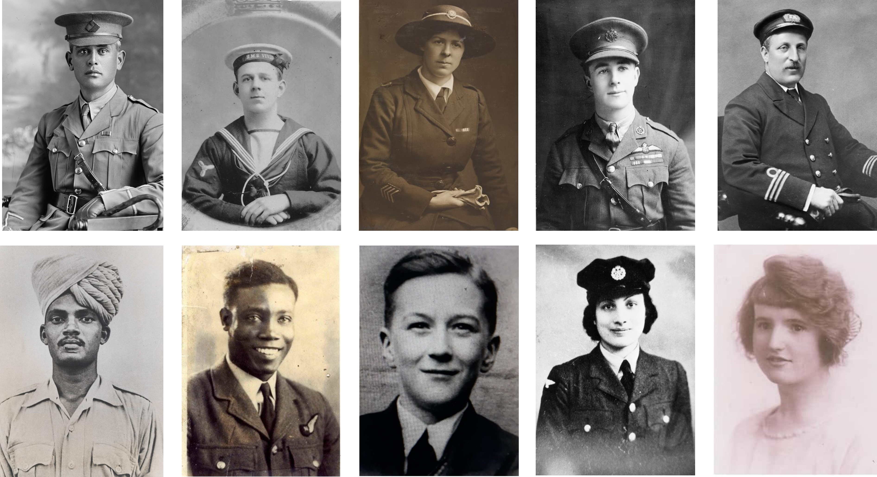
Who do we commemorate?
Notes:
WHO we commemorate​
an individual is commemorated by the CWGC if they were: ​​
​​
a serving member of the armed forces, merchant navy or other recognised ‘auxiliary organisation’ of the British Empire/Commonwealth. ​​
Or ​​
a former member of the above who served during the war and whose cause of death is attributed to their service ​​
And ​​
died during the First or Second World War (as defined by our Dates of Responsibility). ​​
​​
The work of the Commission is ongoing. Equally, researchers continue to identify service personnel and civilians who died during the war but whose names, for a variety of reasons, were not included in the original records. ​
Every year the graves of around 120-130 servicemen are discovered on the old Western Front alone, some of whom can be identified.
The Commission commemorates all those who died while serving with the armed forces, irrespective of the cause or circumstances of their death;​
or who died subsequent to the termination of their military service and whose death was attributed to that service, ​
or those of merchant navies or other recognised ‘auxiliary organisations’ of the British Empire/Commonwealth, providing they meet certain additional criteria specific to the organisation e.g. their death occurred in a theatre of war, as a result of enemy action, or due to war conditions​
​
All must have died during the First and Second World War (as defined by our Dates of Responsibility). ​
​​
A simpler way to look at this:​​
​​

Slide 5
Teaching notes
Outline activities are intended as guidance only – the resource has been designed to be adaptable to your own requirements.
Activity 1 - Context
Read the information sheet about the first poet.
Students highlight what they think are the key 5 facts about them.
They decide which one key fact they find most interesting and share with class with an explanation.
Activity 2 – Look at poem
Read poem and ask for initial thoughts on what they are saying about their experience of war.
Detailed analysis and annotation using prompt questions on slides – adapt this to your teaching objectives.
Draw final conclusions on how experience of poet has affected what they write about.
Activity 3 – Comparison
Once all three poems have been analysed, draw out comparisons between experience and how it has been expressed
Activity 4 – Written outcome
The resource is designed to work towards an analytical comparison of two of the poems using the question:
‘Compare how writers during the First World War explore their personal experiences of conflict’

Slide 6
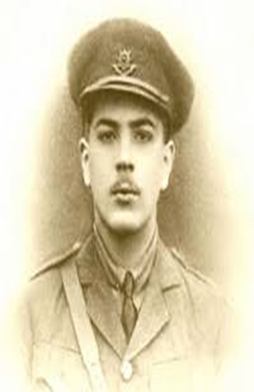
Vera Brittain
‘Perhaps’
This is the dedication on the poem:
‘To RAL – Roland Aubrey Leighton 1895-1915’
What do you expect from the poem having read this?
Notes:
Image of Roland Leighton – Brittain’s fiancee

Slide 7
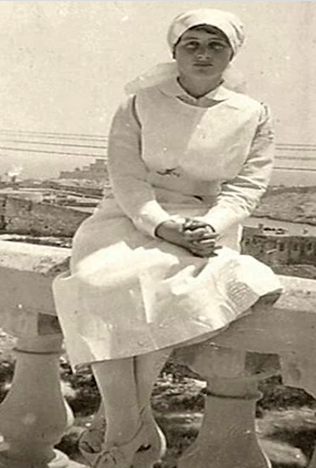
Vera Brittain
‘Perhaps’
What is your first emotional response to this poem
Who do you think the poet is speaking to in the poem?
What effect does the repeated use of the word ‘perhaps’ have?
What does it tell us about Brittain’s emotions?
How does Brittain use nature as a contrast to her feelings?
What is the pattern in the structure and why does it change in the last stanza?
Notes:
Brittain’s poem is full of grief and an inability to look to the future.
Use of first person
Repetition/anaphora of ‘perhaps’
Modal verbs – ‘shall’ , ‘may’
Structural contrast between beauty of Nature and her inability to enjoy it
Capitalisation of ‘You’ to elevate Roland
Relevance of Christmas – link to date of Roland’s death
Personification of Time
Repetition of ideas in last line of each stanza
Structural change in last stanza – ‘But’ and different pattern to emphasise final loss

Slide 8
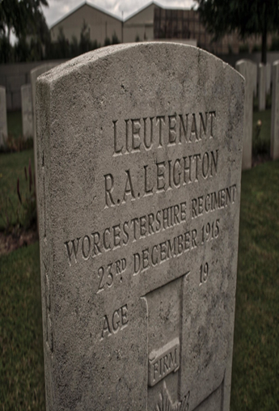
Vera Brittain
‘Perhaps’
How does our knowledge of Brittain’s relationship with Roland Leighton help us understand this poem?

Slide 9
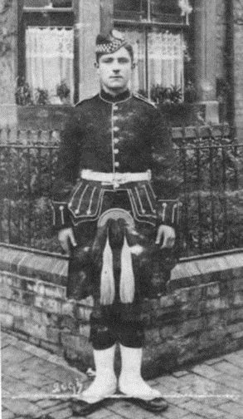
Ewart Alan Mackintosh
‘In Memoriam’
This is the dedication on the poem:
‘For Private D Sutherland killed in action in the German trench, May 16th, 1916, and the others who died.’
What do you expect from the poem having read this?
Notes:
Image of Private Davis Sutherland

Slide 10
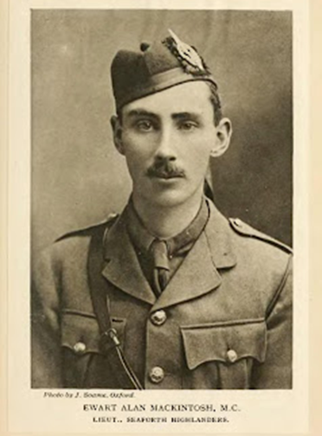
Ewart Alan Mackintosh
‘In Memoriam’
What is your first emotional response to the poem?
Who is the poet speaking to in the poem?
Can you find examples of is Mackintosh’s attitude towards the fathers?
Why would Mackintosh have seen David’s letters and what did he write in them? Why might this be?
Why does Mackintosh feel he is more of a father to his men?
Can you find examples of the emotions he expresses about his men and their deaths.
Notes:
Direct address to father – changes to direct address to David and the other men lost in stanza 4
Use of first person
As David’s officer, Mackintosh would have read and censored David’s letters home
Imagery and emotive language used to describe the contrast between ‘little helpless babies’ and ‘piteous writhing bodies’
Triplet – ‘happy & young & gallant’
Repetition of ‘Oh/O’ (ecphonesis) to emphasise emotion
Effect of ‘only’ in penultimate line
Effect of structural device of ‘But’ at beginning of last line

Slide 11
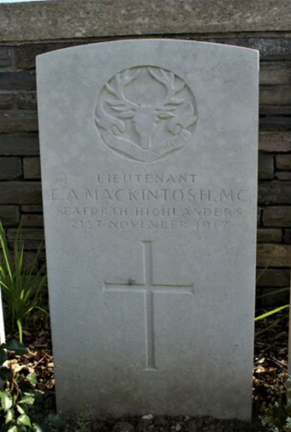
Ewart Alan Mackintosh
‘In Memoriam’
How does our knowledge of Mackintosh’s relationship with his men help us understand his poem?

Slide 12
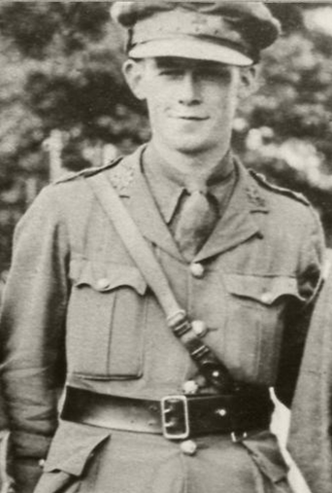
William Noel Hodgson
‘Before Action’
Hodgson’s poem was published on the 29th June, 1916, and is believed to have been written in the couple of weeks before that date – why might this be relevant to our understanding of his personal experience?

Slide 13
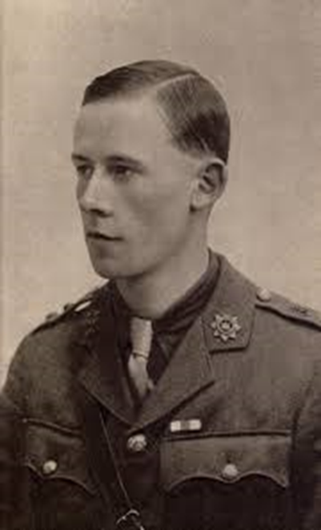
William Noel Hodgson
‘Before Action’
What is your first emotional reaction to the poem?
Pick out examples of where Hodgson presents the beauty of the world around him
What language does Hodgson use that suggests sadness?
Can you find examples of language that suggest sacrifice?
Can you explain how the final line of each stanza works and develops across the poem?
Notes:
Prayer - like structure – changing of final wish from God in last lines – how does this develop?
Imperatives in last lines of stanza
Adverbs in first stanza suggest he hasn’t always appreciated what’s around him – developed further in third stanza ‘uncomprehending eyes’
Rich imagery in description of the beauty of the world around him
Use of first person
Symbolism of the metaphor of sunset

Slide 14
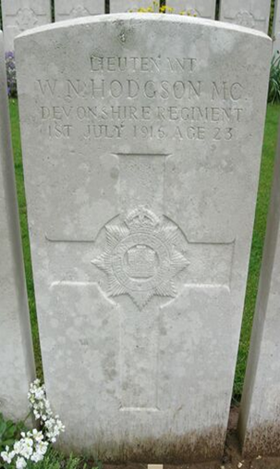
William Noel Hodgson
‘Before Action’
How does our knowledge of Hodgson’s war experience help us understand his poem?

Slide 15

‘Compare how writers during the First World War explore their personal experiences of conflict’

