Slide 1
Flowers of Remembrance
Aimed at children aged 7-11

Slide 2
Teaching notes
Stage 1
Divide the class into small groups
Each group will get an information card (slides 8-13) on one of the flowers of remembrance
They should read through the card and try to remember three key things about that flower. They can then test each other to see what they can remember
Record what they have learned on the sheet – slide 3
Repeat for each flower by passing the sheets on to the next group
Stage 2
Pupils are going to design a remembrance wreath which uses the remembrance flowers of different countries to remember all those who died in the world wars
They can use the template on slide 4 and should try to include a range of different flowers which they have learned about
Stage 3
Create a Remembrance display in your school
Share your pupils’ work on social media using the hashtag #RemembranceIs, or email your photos to education@cwgc.org

Slide 3
Name of Flower | Which countries use it as a flower of remembrance? | Origins

Slide 4


Slide 5
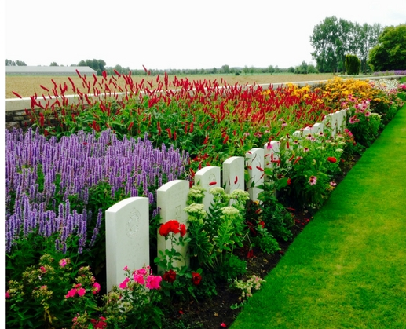
Flowers of Remembrance
A number of flowers are linked to remembrance. This is a tradition that goes back thousands of years.
After the First World War, many countries adopted flowers as symbols of remembrance. People would wear a flower to remember those who had died.
Each year in the UK and across the Commonwealth, people wear a poppy to remember those killed in wars, especially the First and Second World Wars.

Slide 6
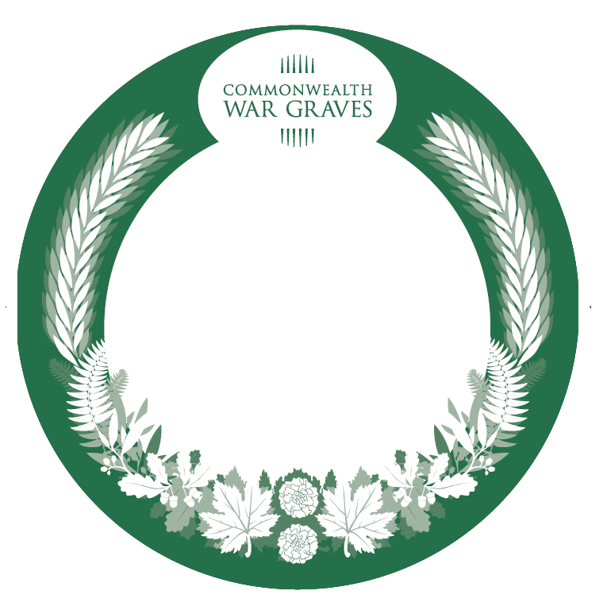
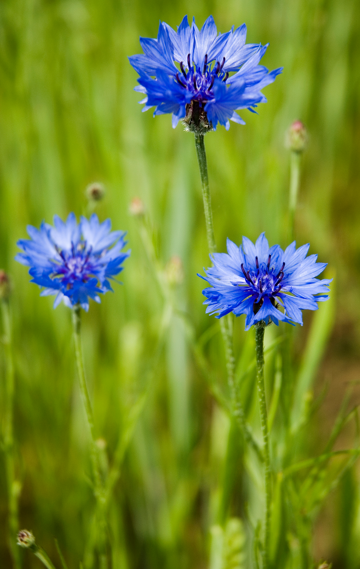
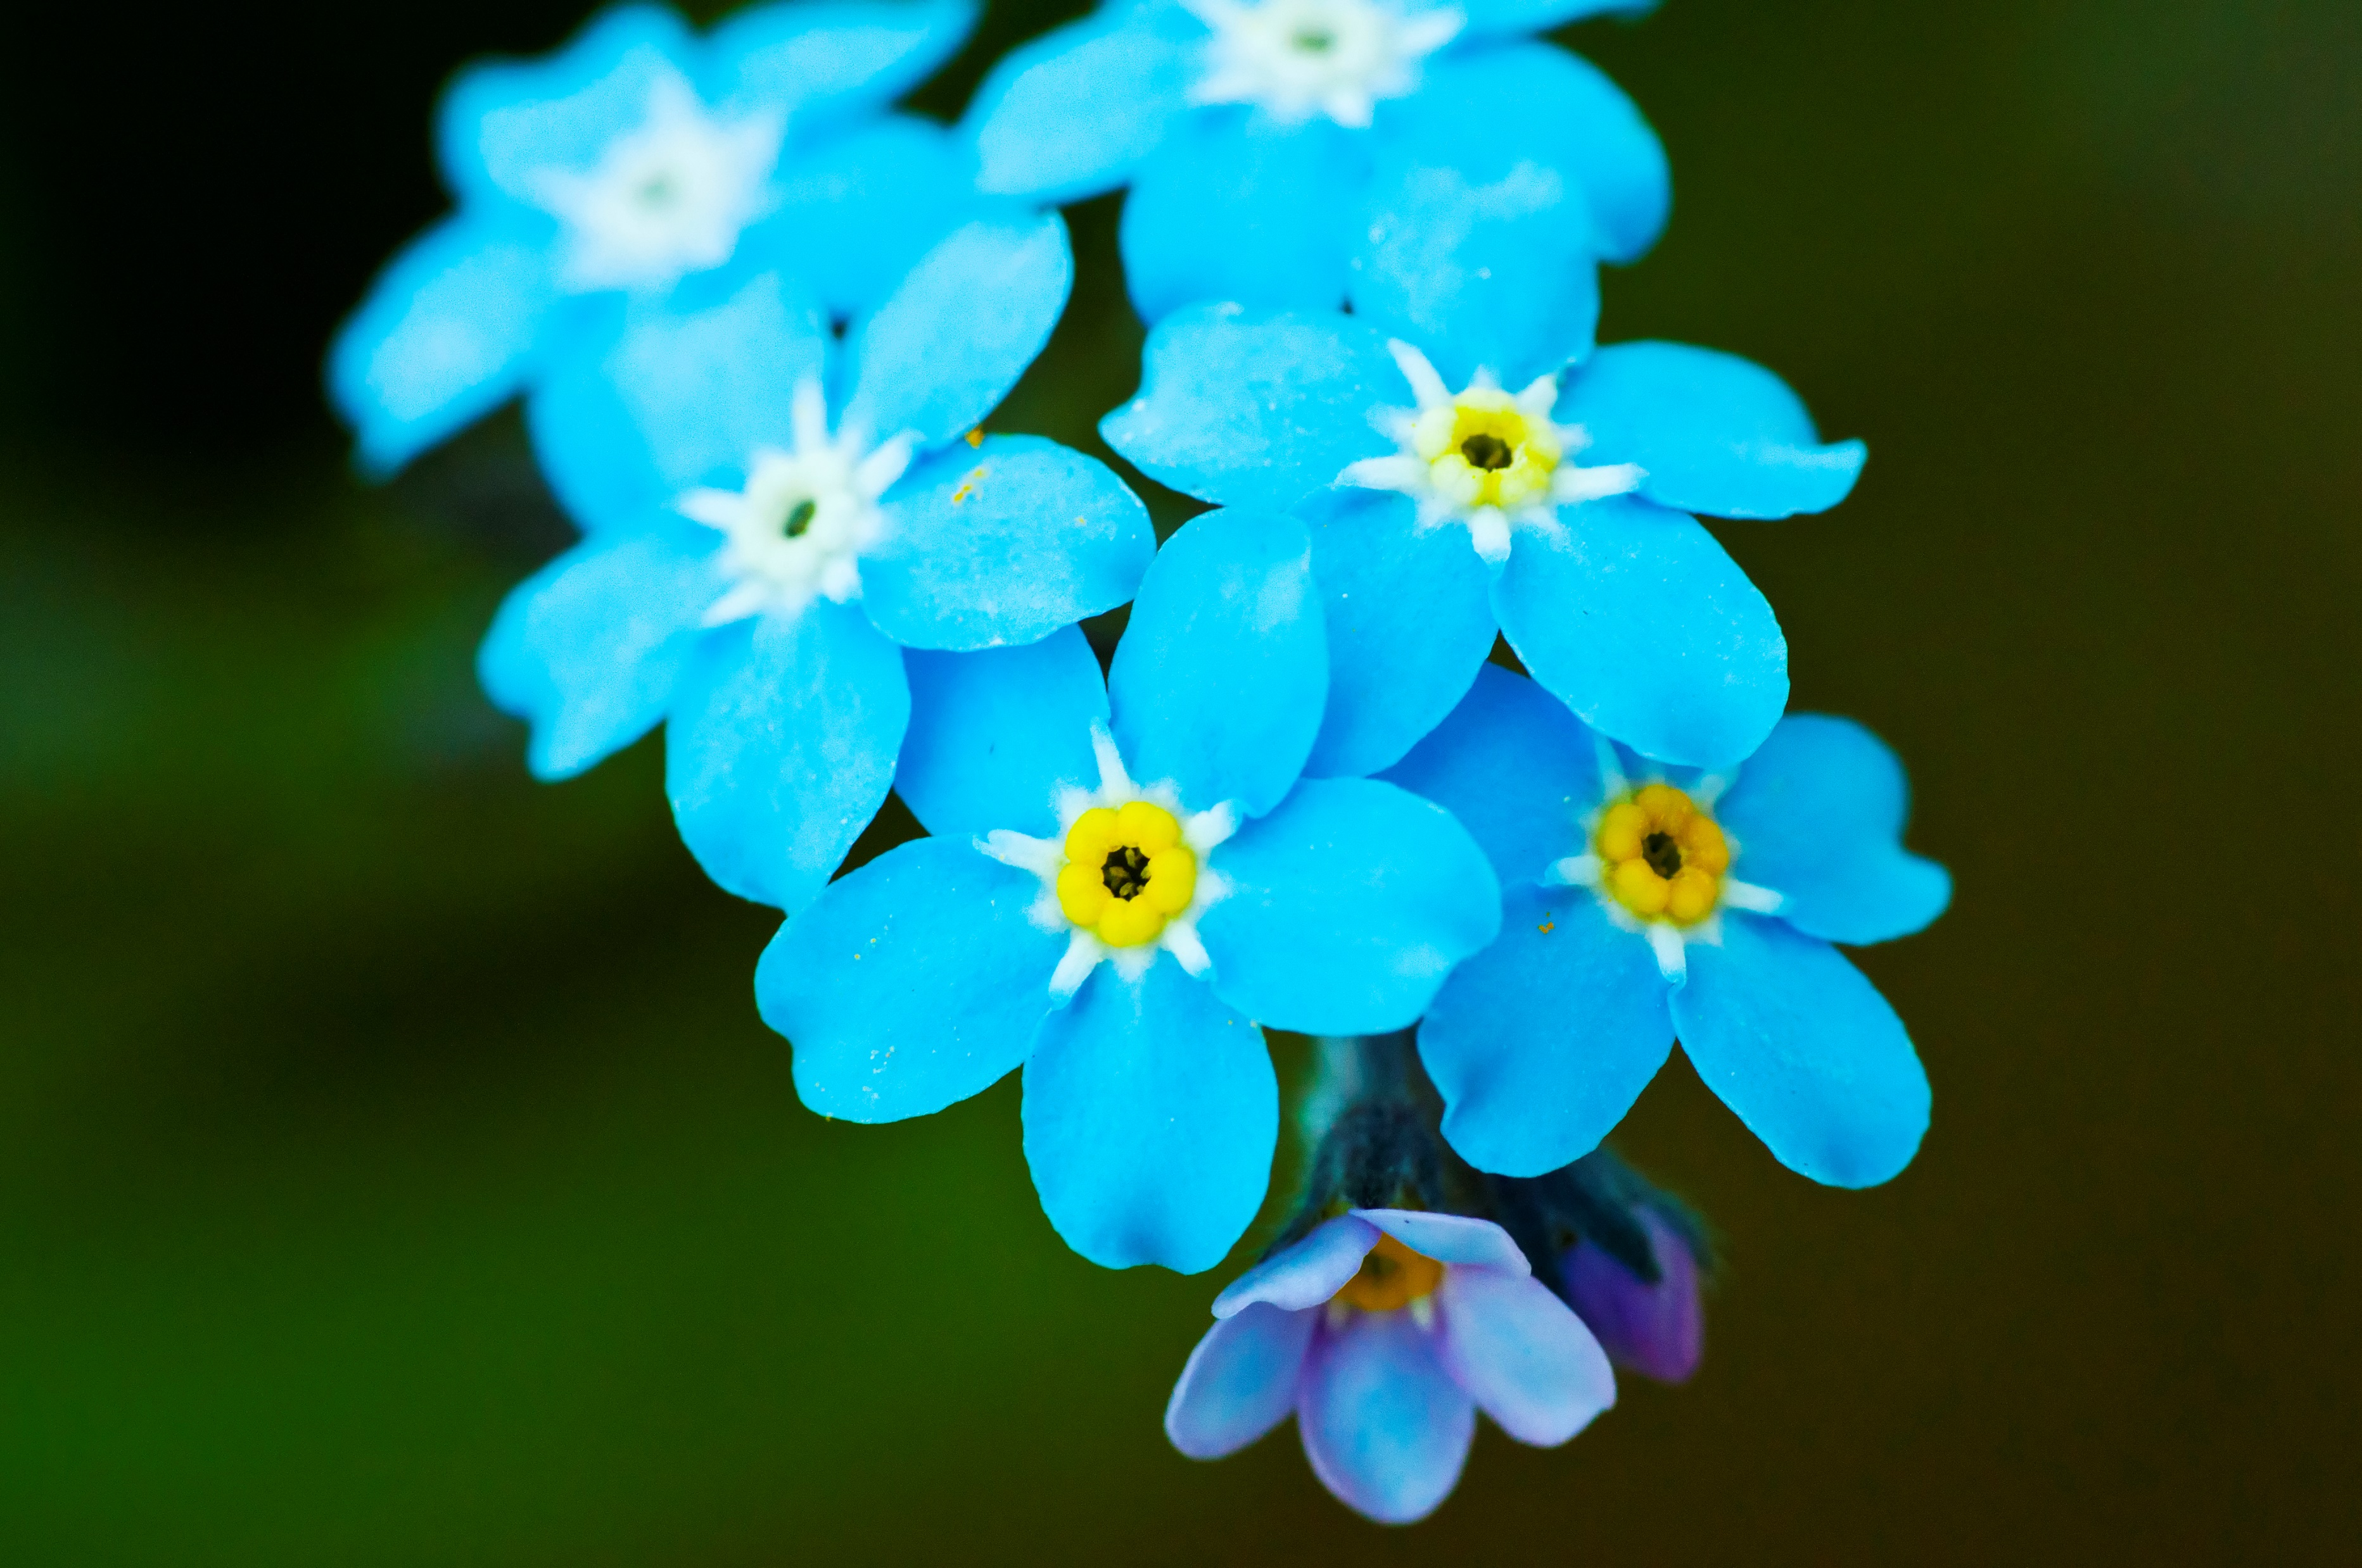
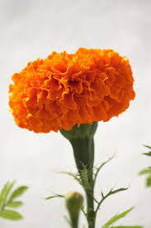
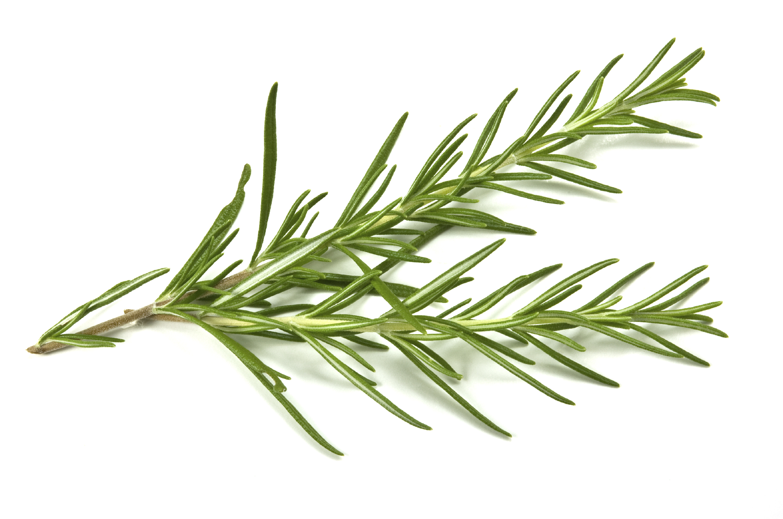
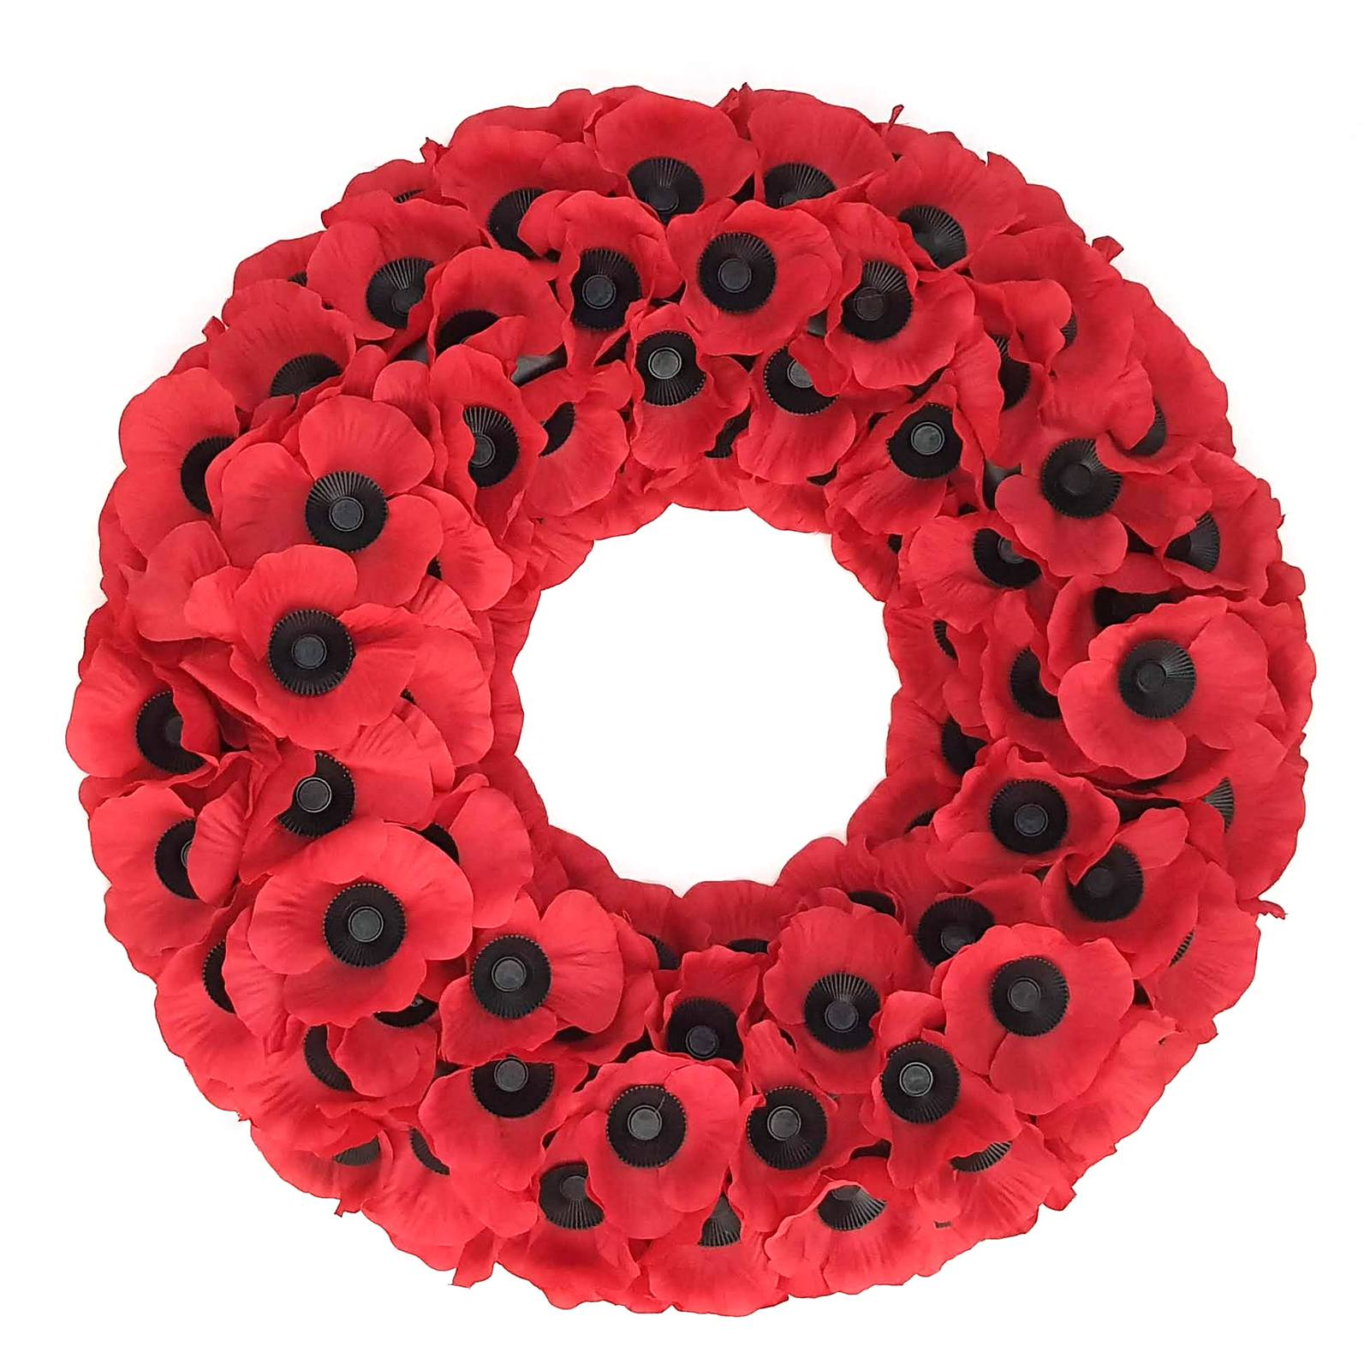
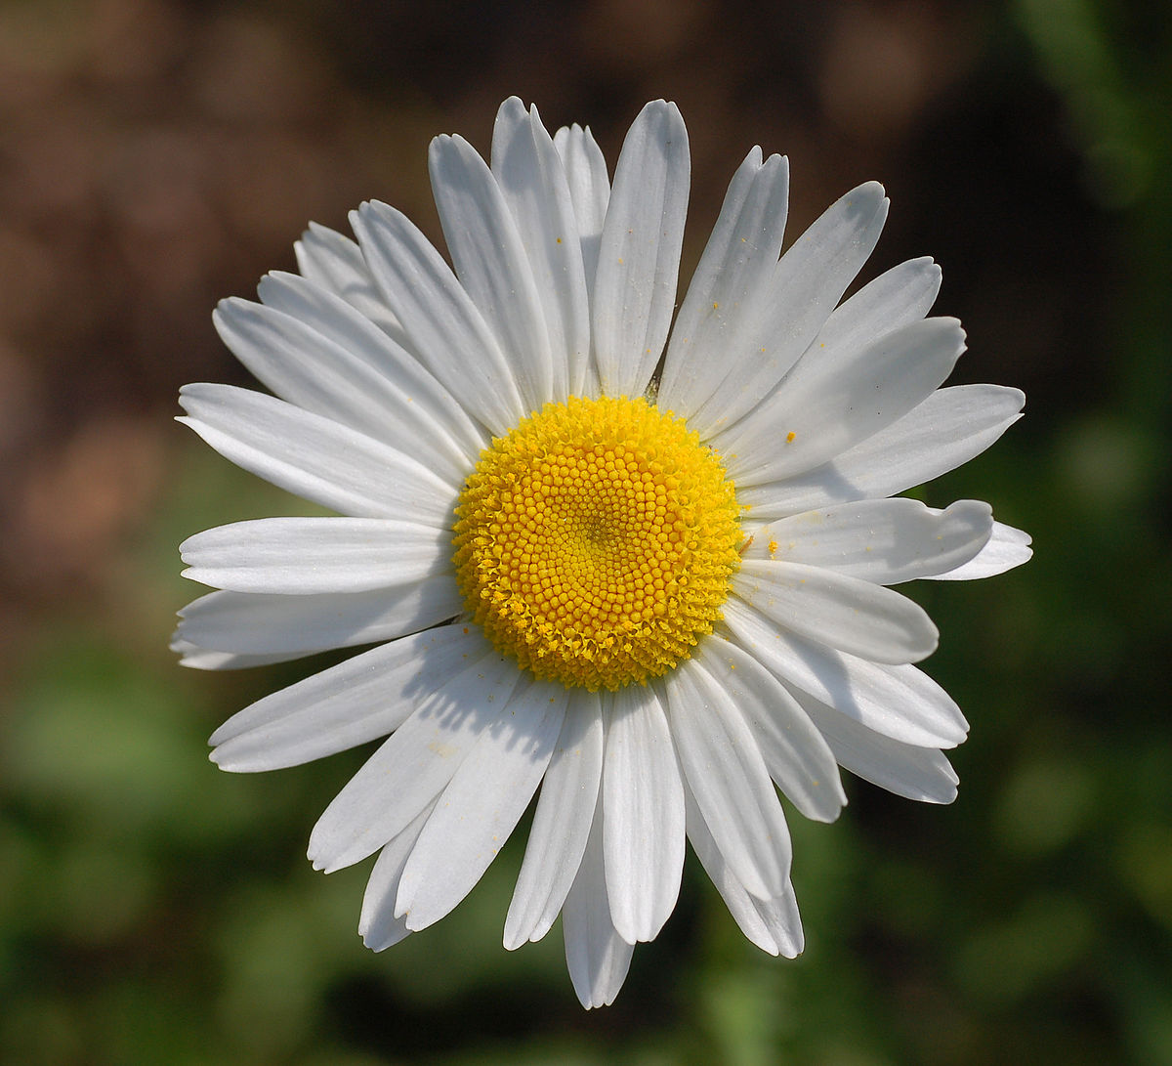
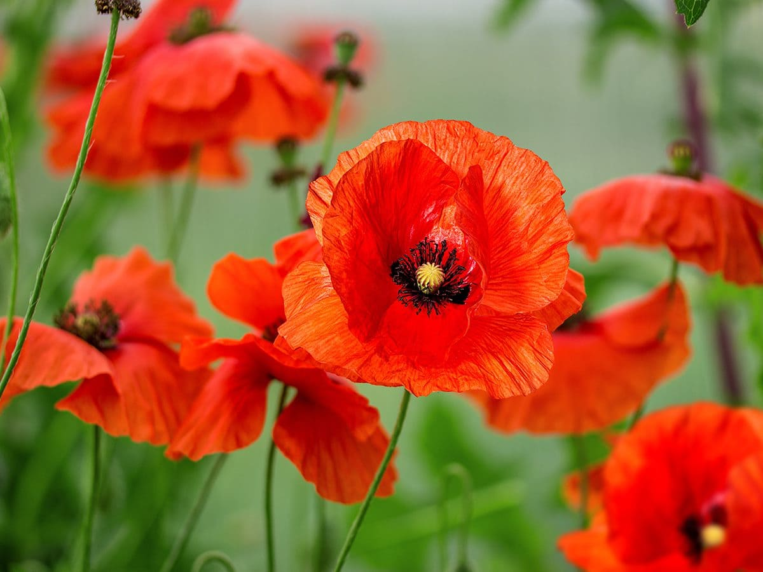
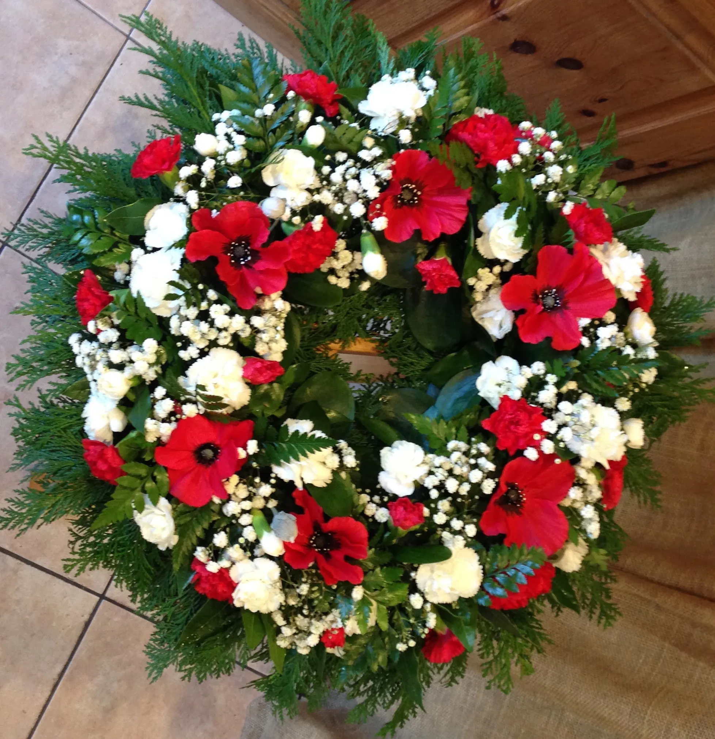
Flowers of Remembrance
Activity: Use the flowers of remembrance to create your own Remembrance wreath

Slide 7
Information sheets

Slide 8
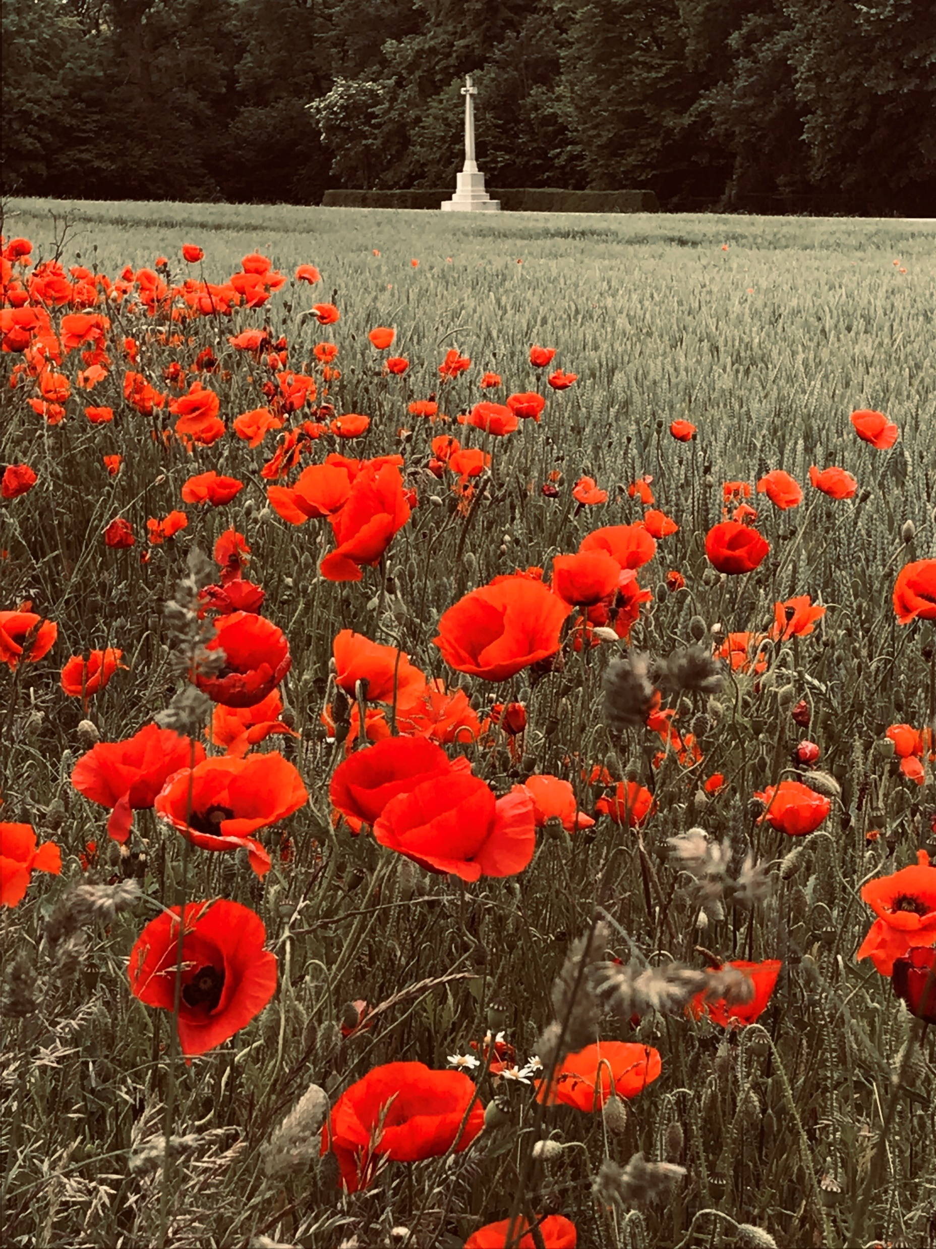
The Poppy
Countries: UK and Commonwealth, USA
Origins
The poppy was one of the first flowers to grow again on the battlefields after the First World War.
It was first suggested as a flower of remembrance in 1918. It became very popular for people in Britain and across the Commonwealth.
Every November, people wear a poppy to remember those who died in war.

Slide 9
The Cornflower
Country: France
Origins
The Cornflower was first used in France during 1914, not long after the start of the First World War.
It reminded soldiers of the battlefields. The cornflower grew on the battlefields, where the ground had been disturbed.
It became the French flower of remembrance after the First World War. It was the official flower of remembrance from 1936.

Slide 10
The Forget-me-not
Countries: Germany, Newfoundland
Origins
It is only in more recent year that the forget-me-not has become the flower of remembrance in Germany.
The name of the flower has strong links to the idea of memory and not forgetting those who have died.
One year after the Battle of the Somme, the people of Newfoundland (now part of Canada) chose to wear the forget-me-not to remember those who had been killed on 1 July 1916. They still wear them on 1 July every year.

Slide 11
The Daisy
Country: Belgium
Origins
The daisy is seen as a symbol of being innocent and pure.
In Belgium it was worn as a symbol of remembrance after the First world War.
During the Second World War, some people wore a daisy as a symbol of defiance against the German occupation.

Slide 12
The Marigold
Country: India
Origins
In India, the marigold has traditionally been used for festivals, weddings and in temples.
They are seen as a flower of ordinary people and therefore, they represent everyone.
In recent years, the marigold has been adopted by many as a flower of remembrance.

Slide 13
Rosemary
Country: Australia
Origins
In 1915 soldiers from Australia and New Zealand fought in Gallipoli, in Turkey.
Rosemary grew wild on the battlefield.
After the First World War, soldiers from Australia started to wear a sprig of rosemary to remember their fallen comrades.
It is often wore on ANZAC Day in April each year.
ANZAC – Australian and New Zealand Army Corps

